Slide 1
Blockchain Application Development using Hyperledger Fabric

Slide 2
Workshop Flow
Four Sessions (2 sessions per day)
Basic overview of blockchain
Permissioned blockchain
Sample Application development (ERP)
Multipeer setup
Real life working project demonstration

Slide 3
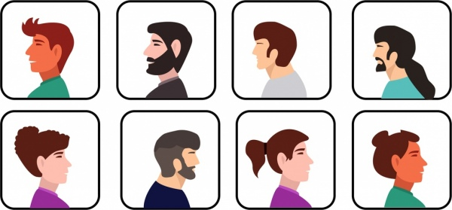


Blockchain overview
Rs. 50
Rs. 50
Alice
Bob

Slide 4

I want to send Rs. 50 to my brother
Rs. 50
Rs. 50
Rs. 50
Alice
Bob
1. Alice sent Rs. 50 to Bob
1. Alice sent Rs. 50 to Bob
Jenny
John
1. Alice sent Rs. 50 to Bob
1. Alice sent Rs. 50 to Bob

Slide 5
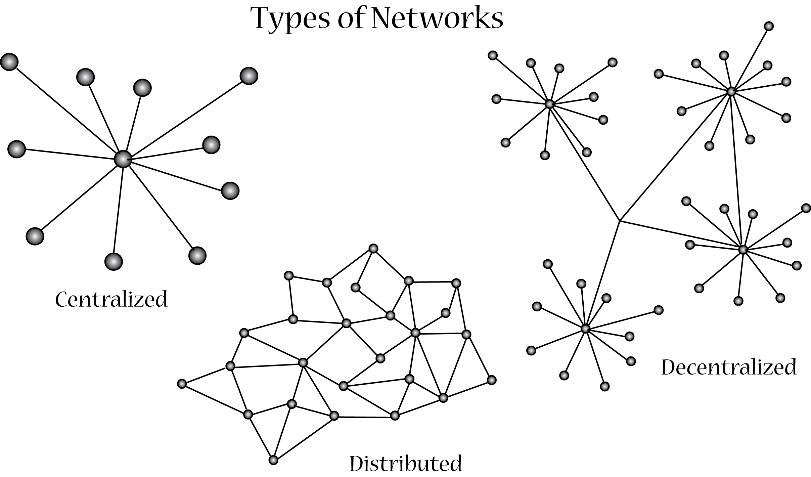

Slide 6
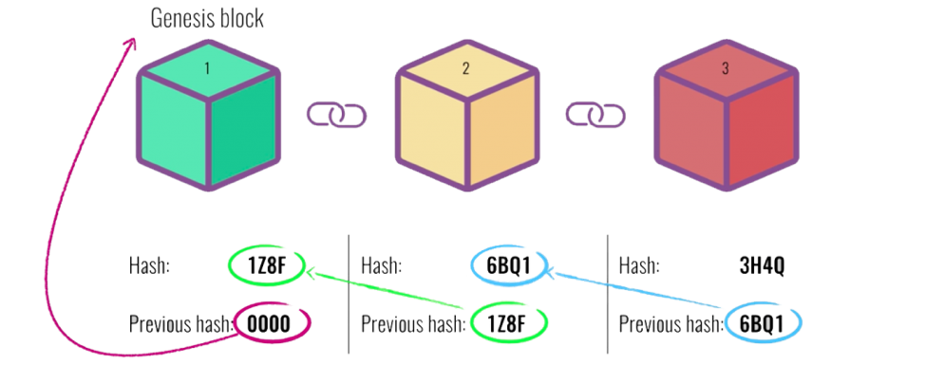
Properties of Blockchain
Single source
of Truth
Decentralization
Blockchain
Consensus
Immutability

Slide 7



Market Scenario

Slide 8
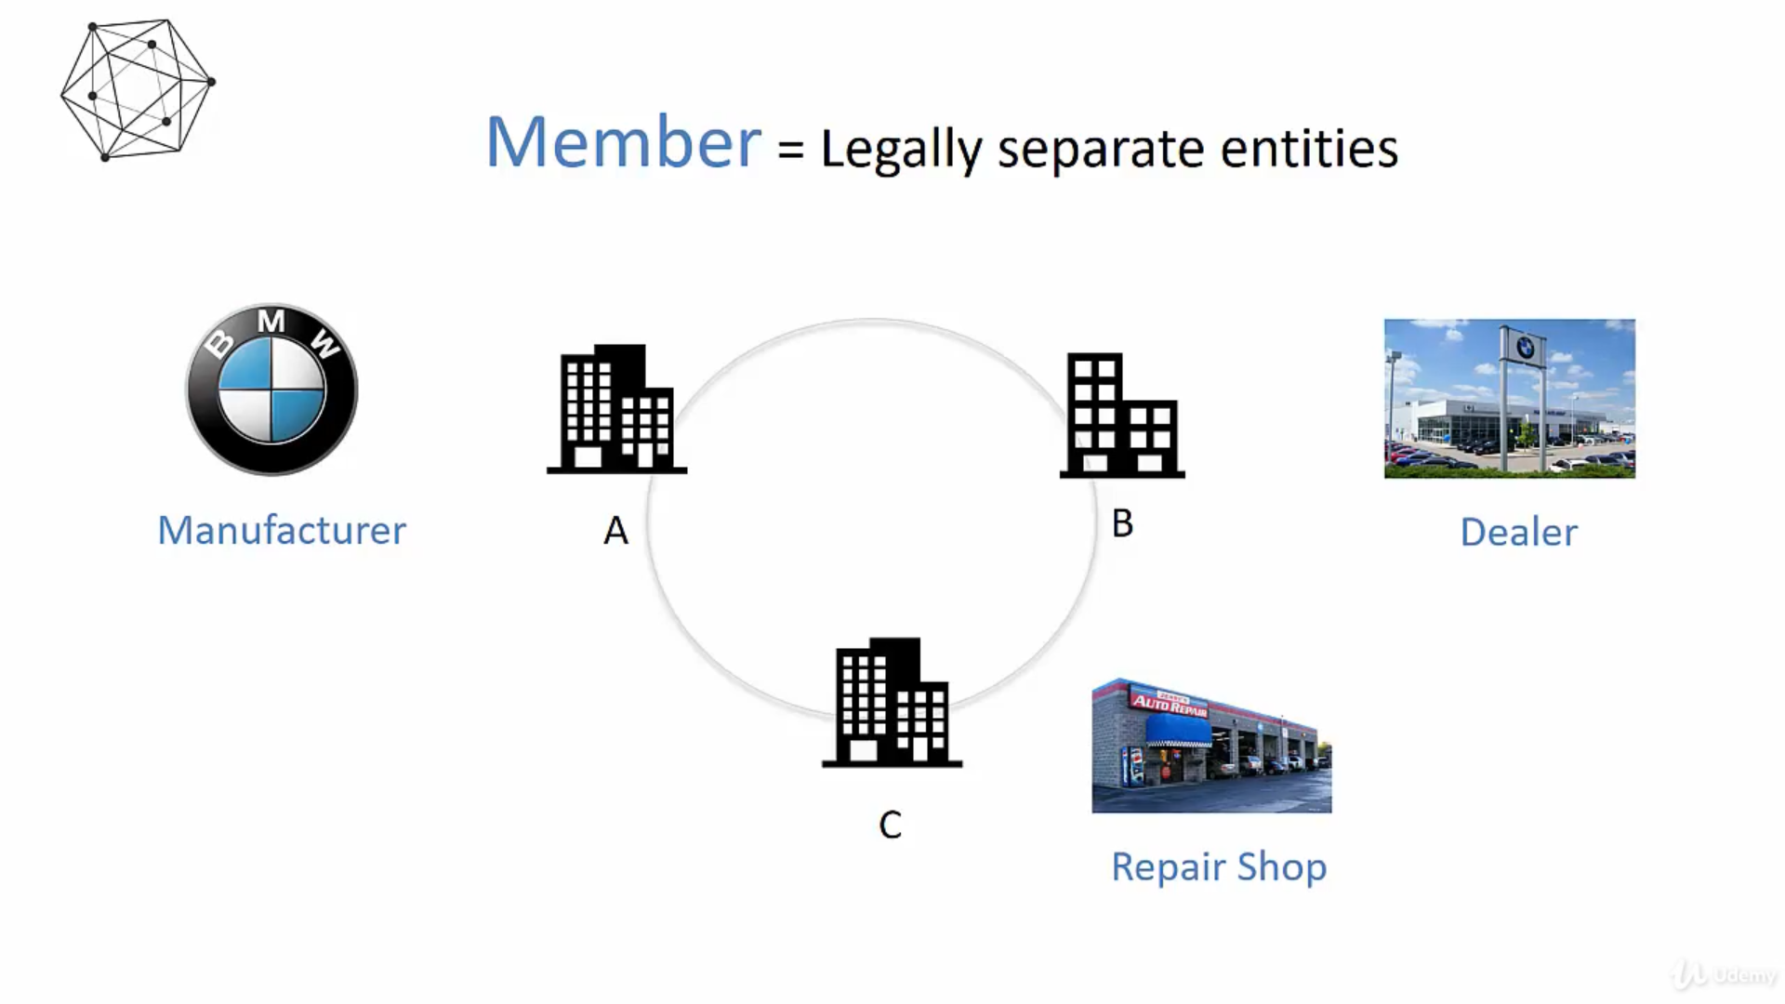

Slide 9
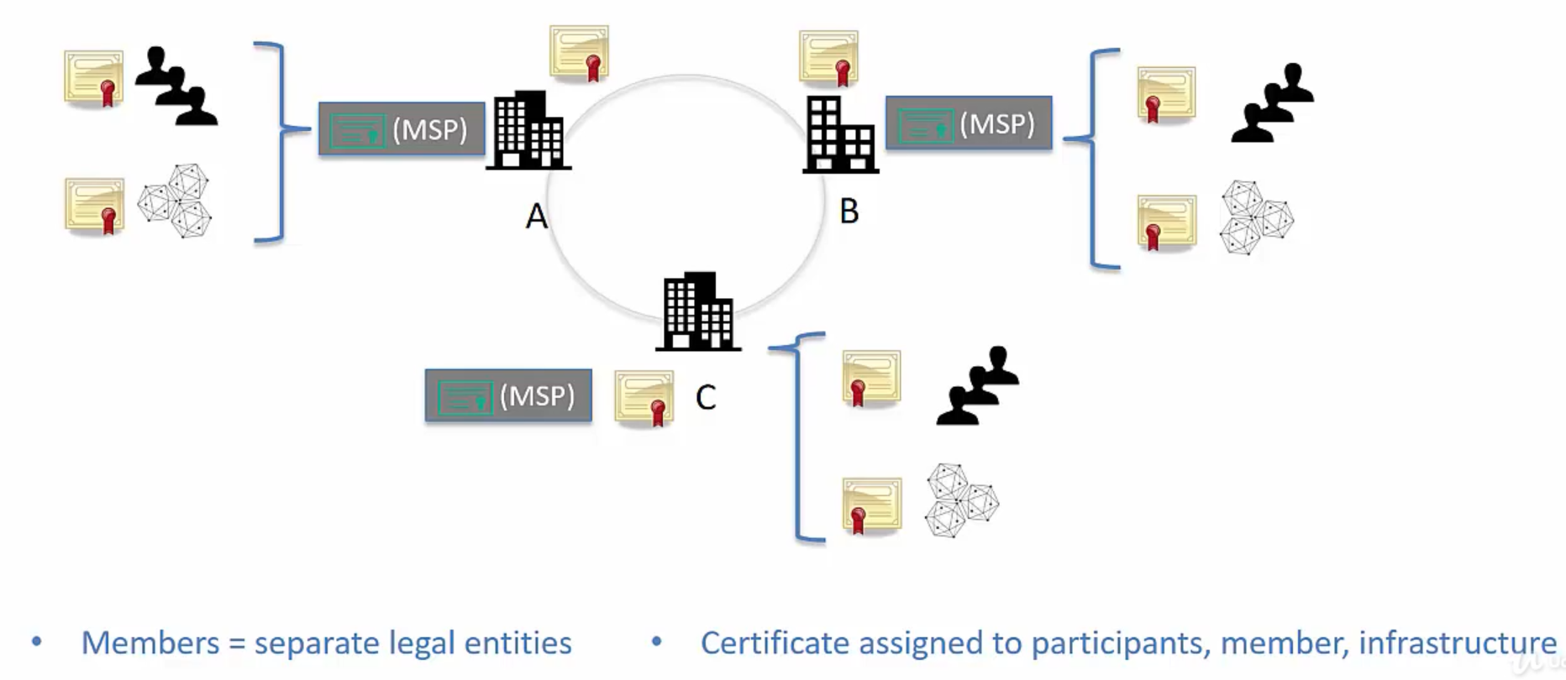
Permissioned Blockchain

Slide 10
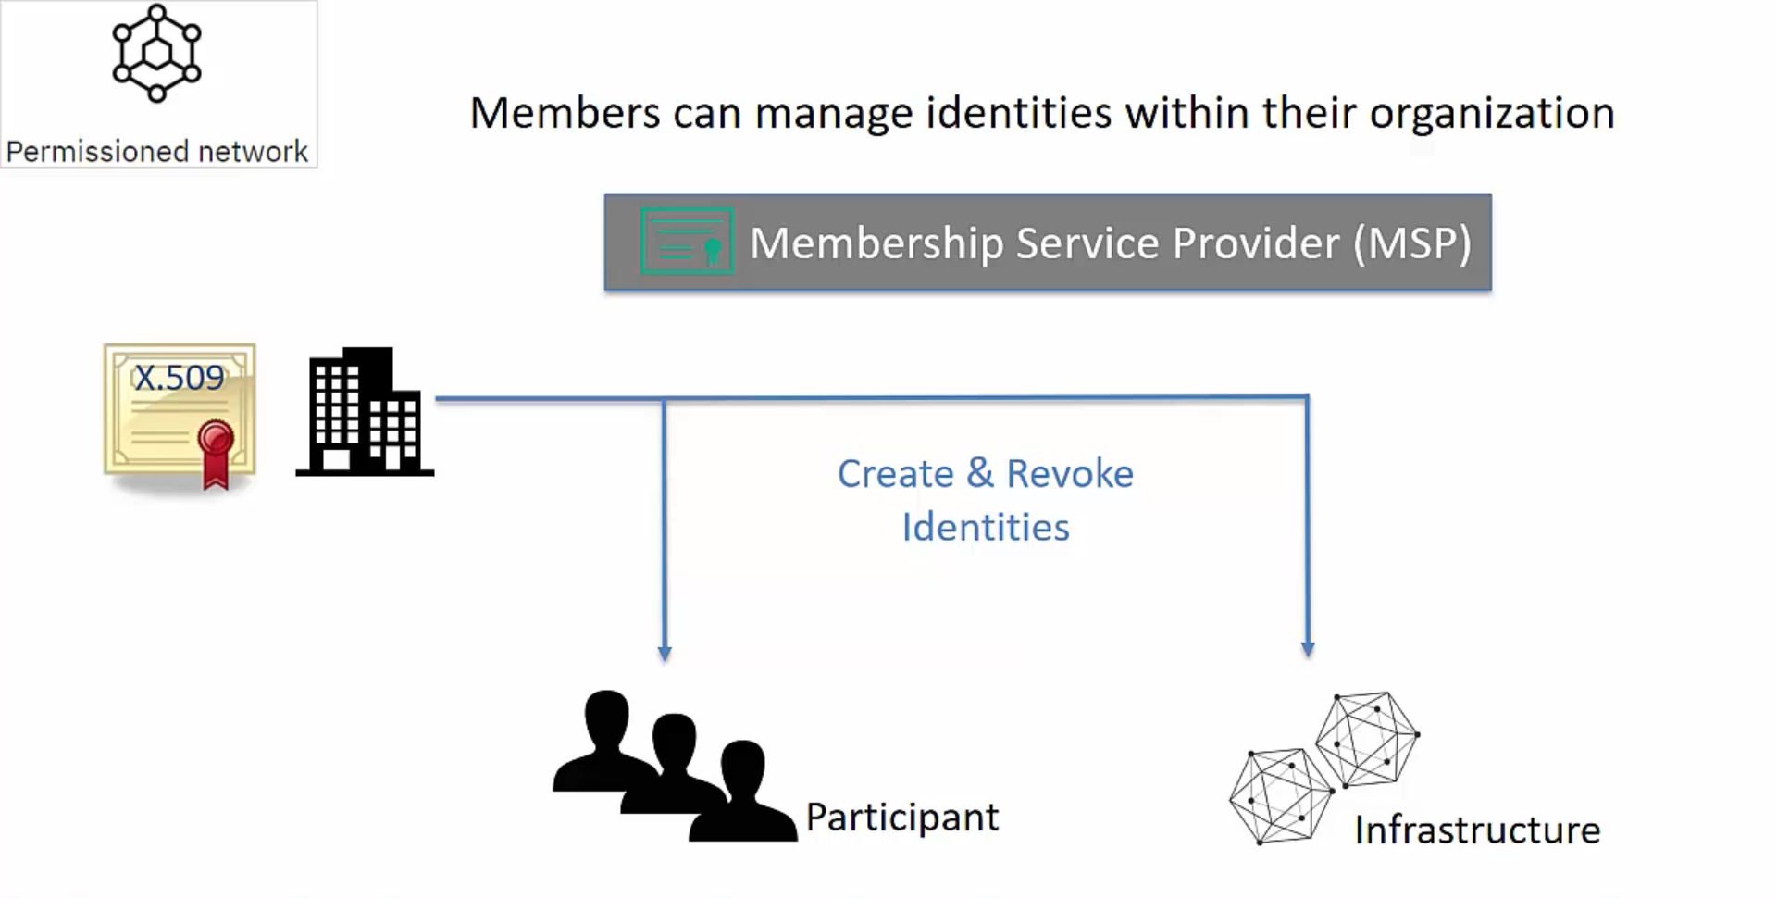

Slide 11
Permissioned Blockchains
Some questions you should have an answer for...
Is public verifiability required?
Are all participants trusted?
Are all participants known?
Are there multiple participants?

Slide 12
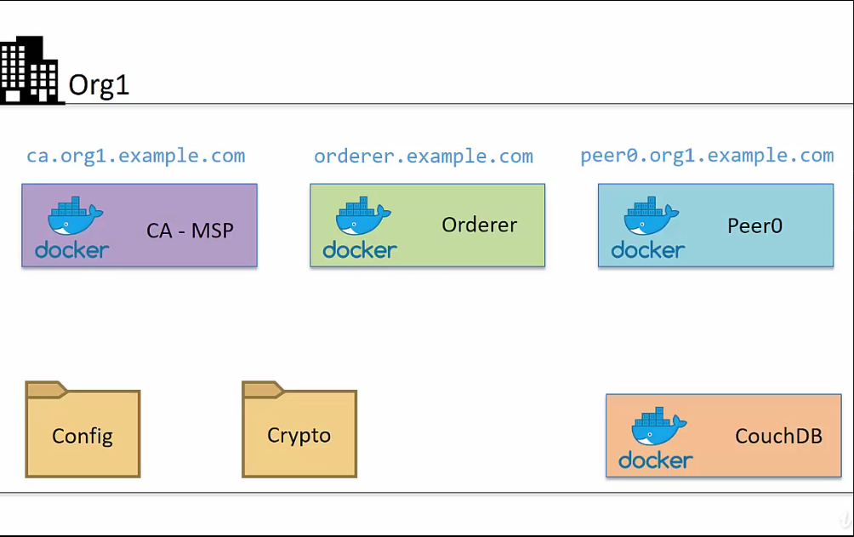
Components of Composer

Slide 13
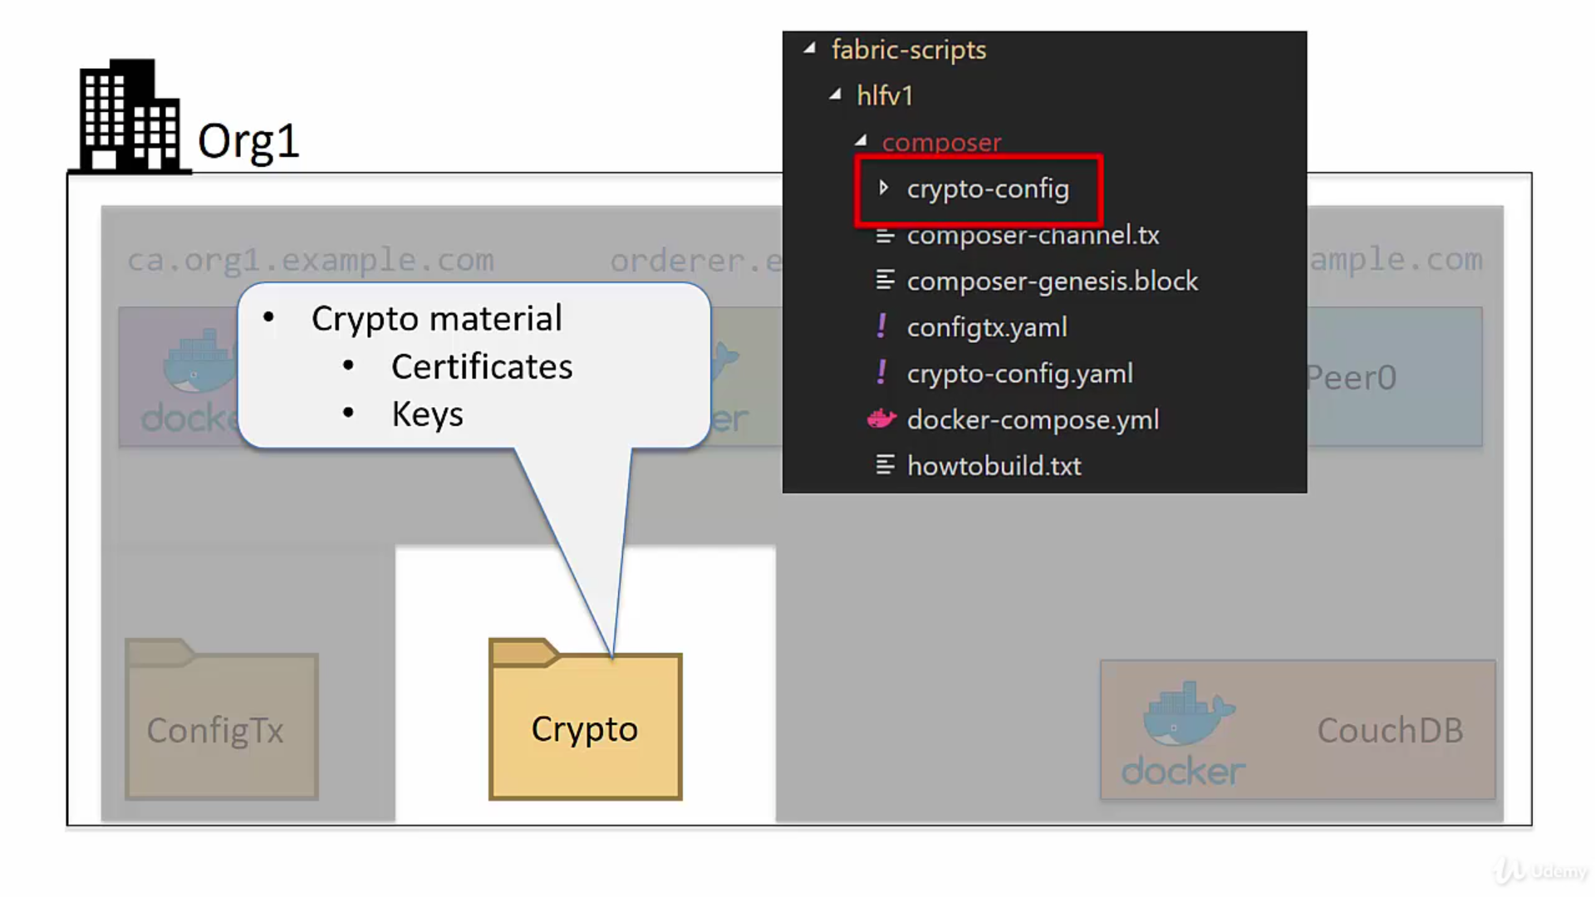
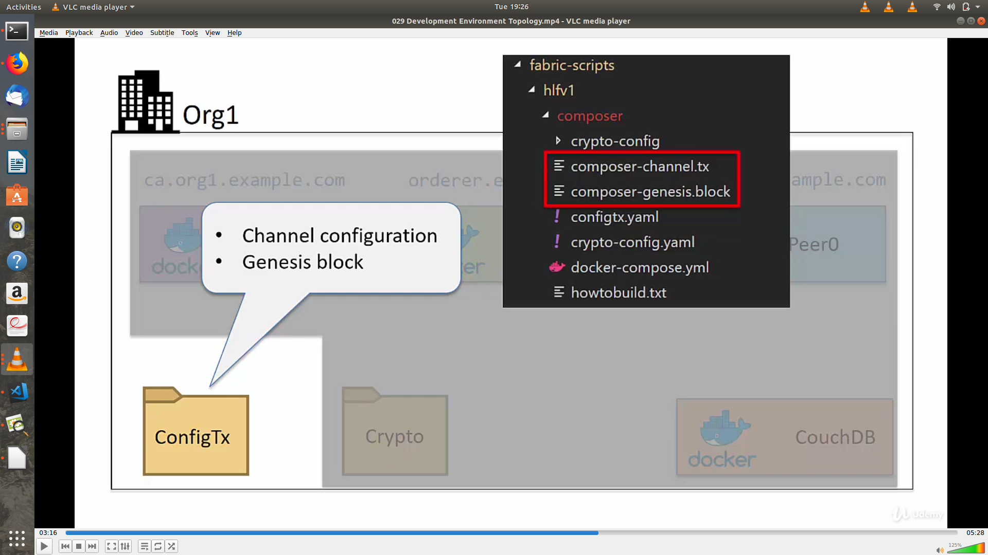

Slide 14
Basic Transaction Flow in Blockchain
Client initiates the transaction
The transaction goes to the peers
Peers verify/validate the transaction.
The verified transaction is put into a block of limited size.
The block is added to the blockchain in every peer.

Slide 15
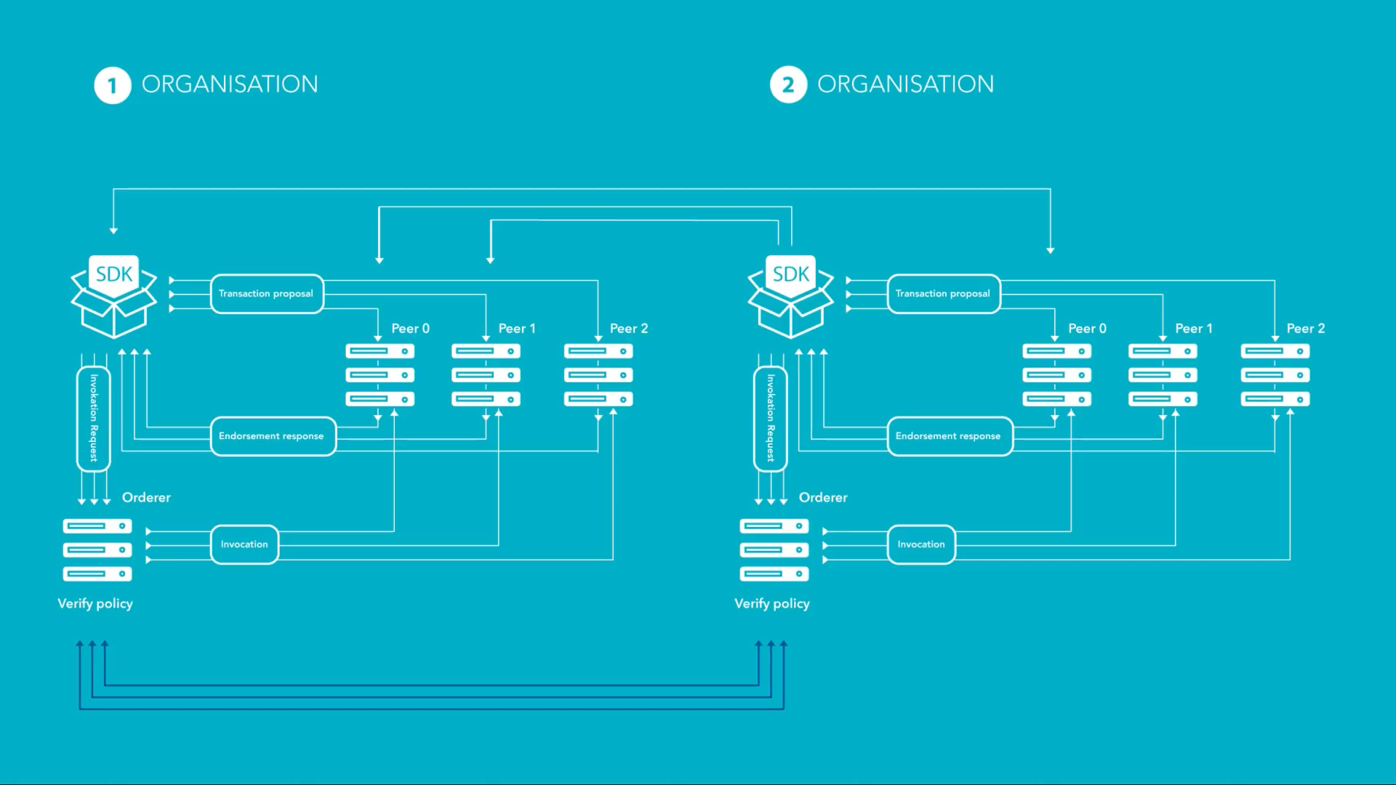
Architecture

Slide 16
Composer
Installation

Slide 17
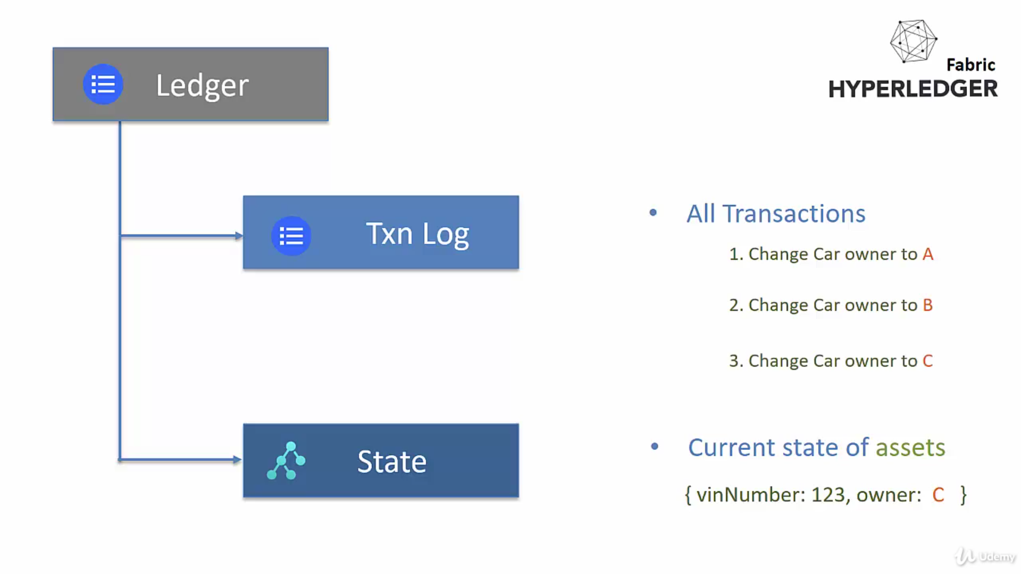
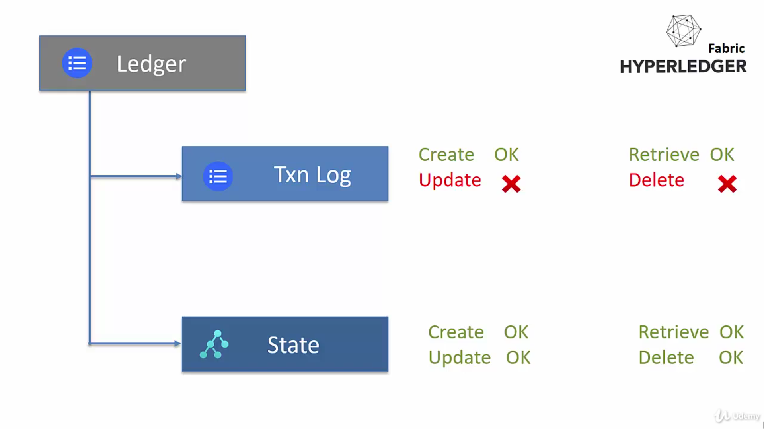
Ledger

Slide 18
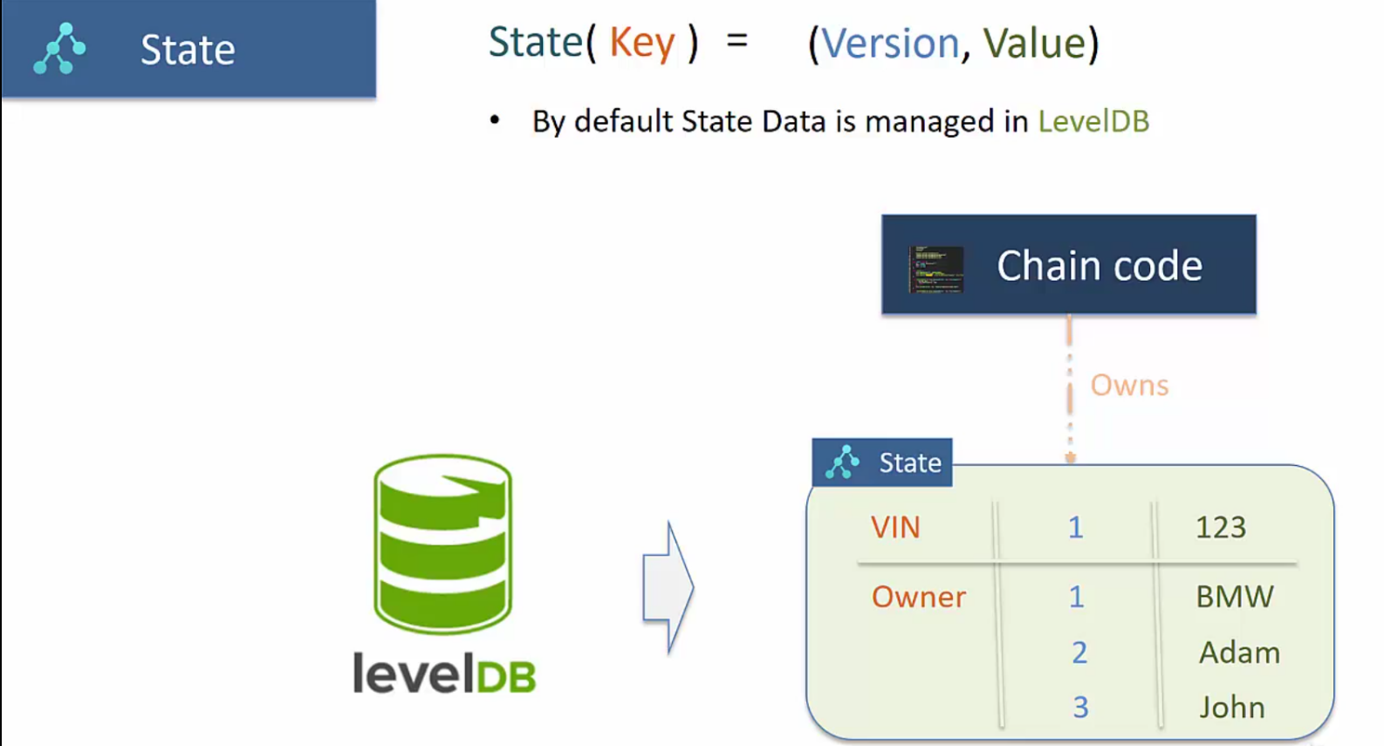
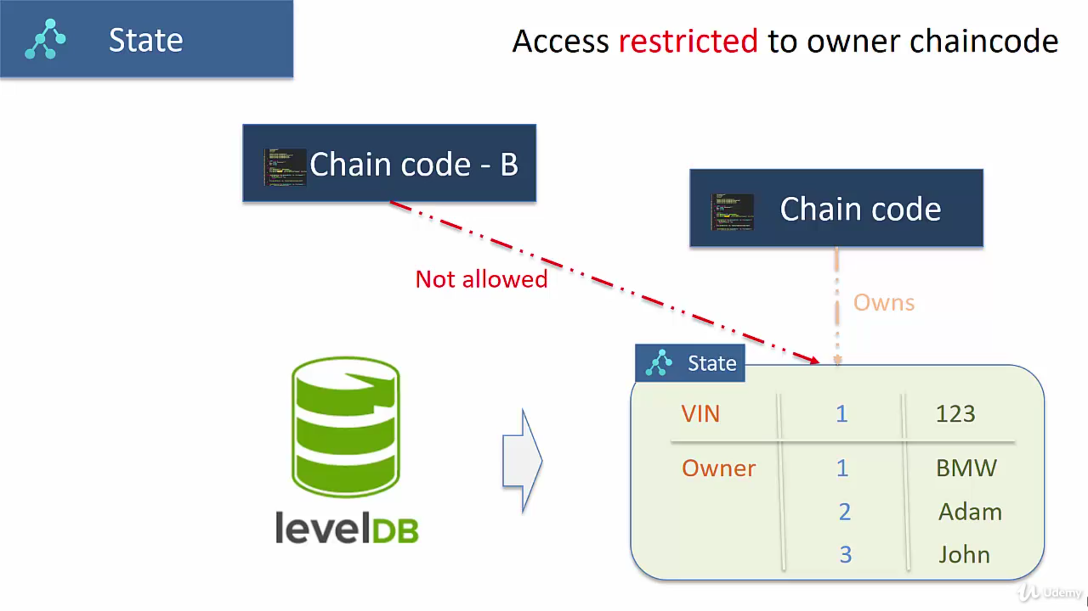

Slide 19
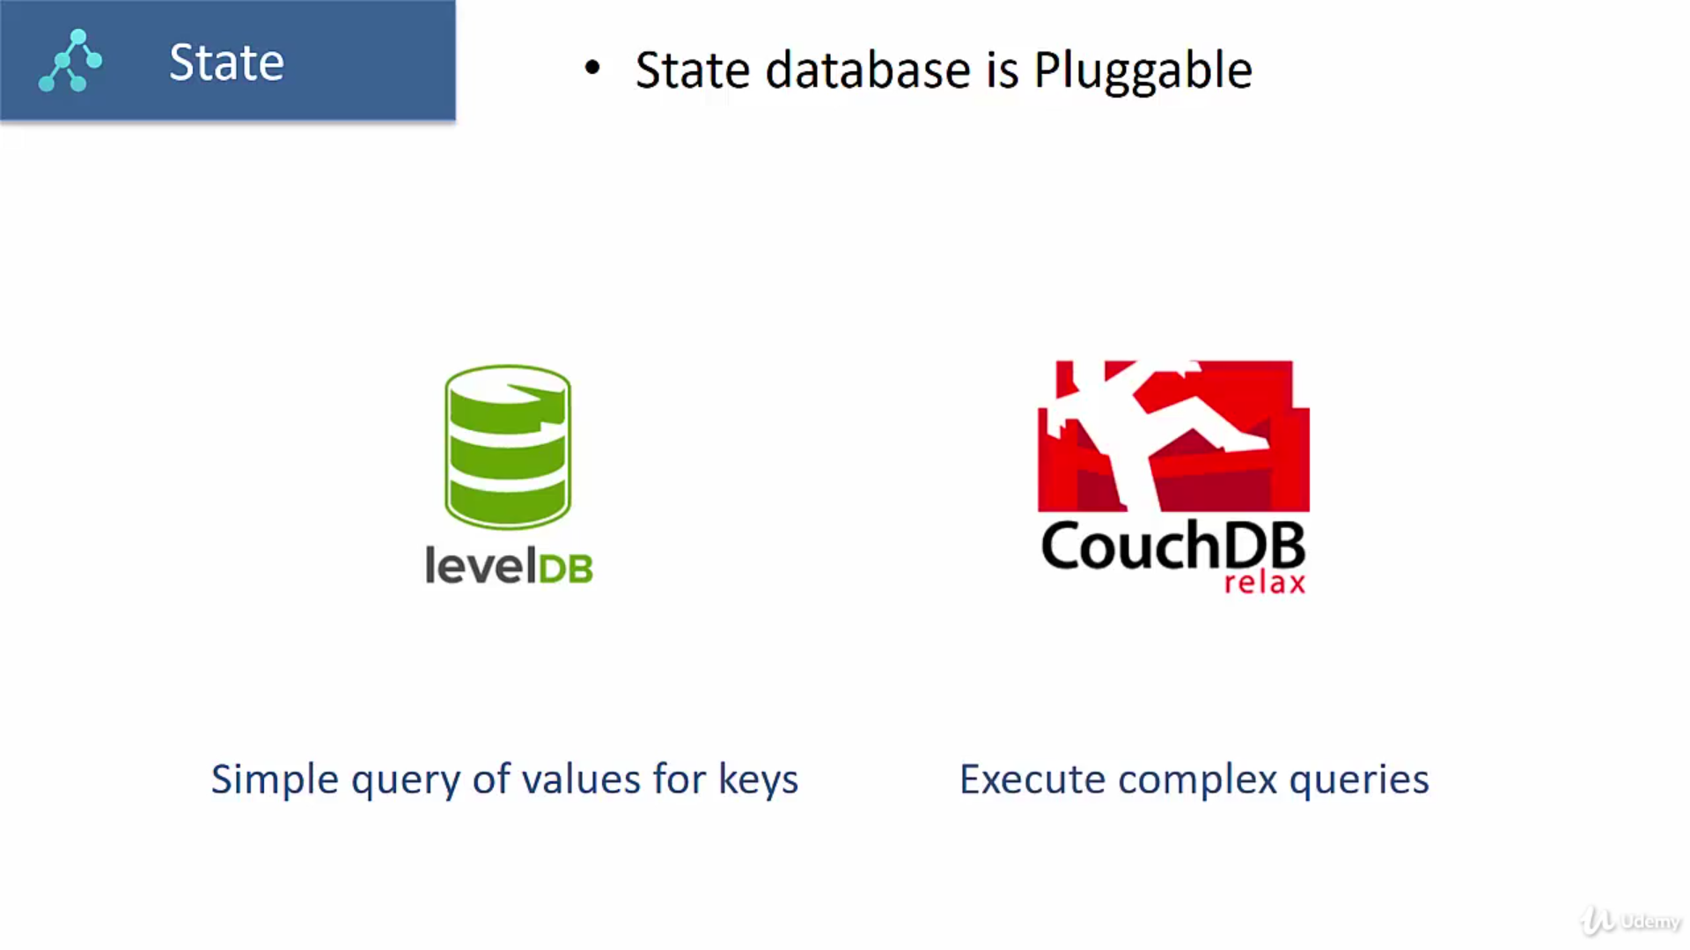
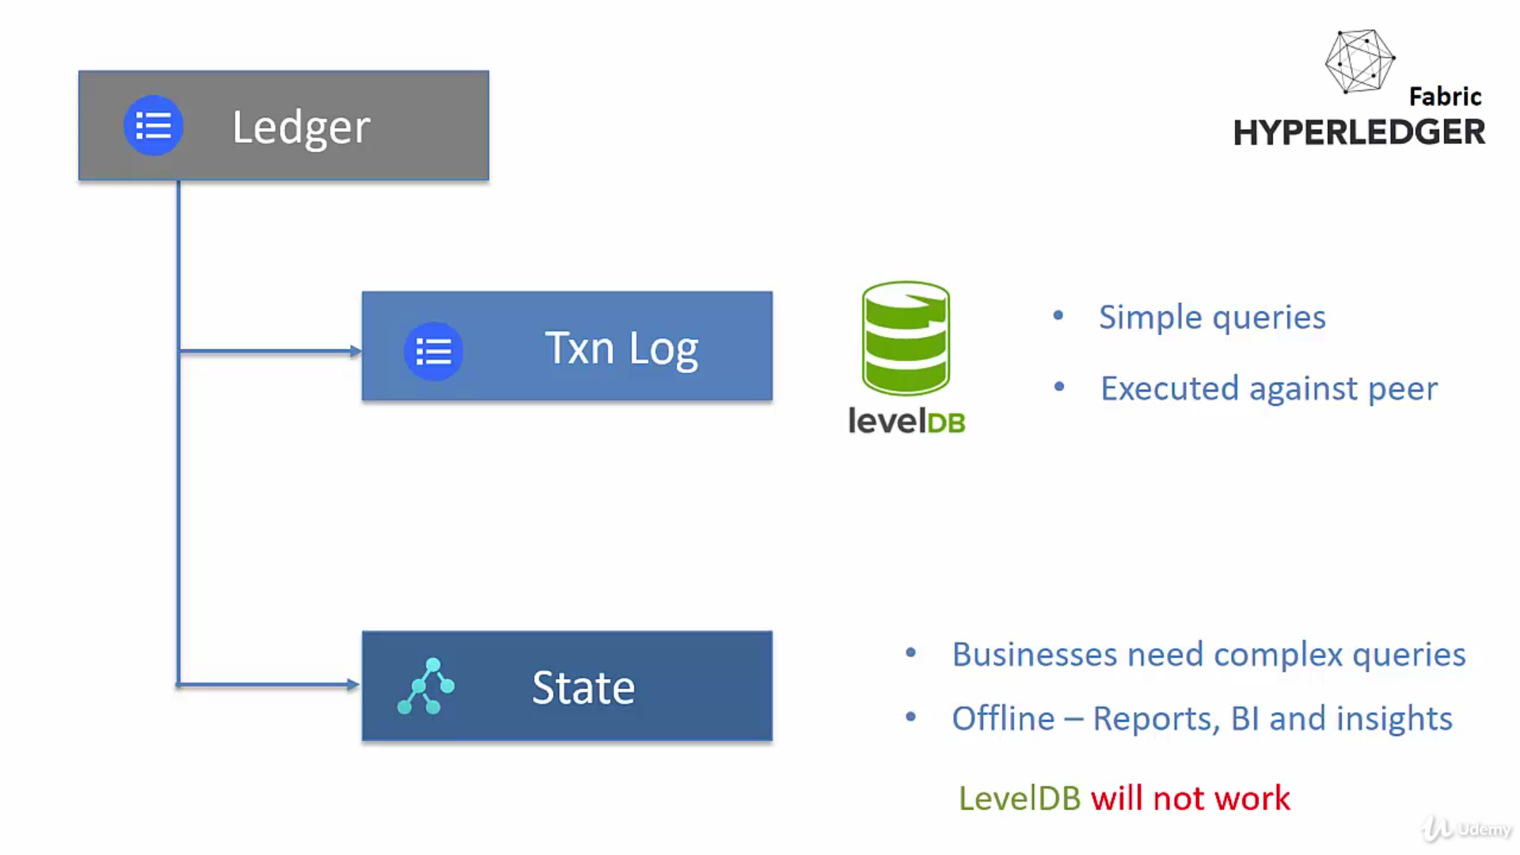

Slide 20
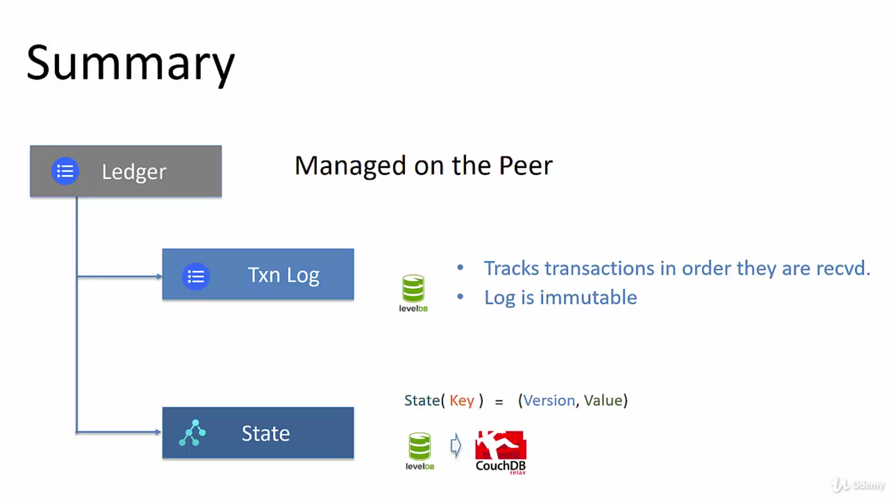

Slide 21
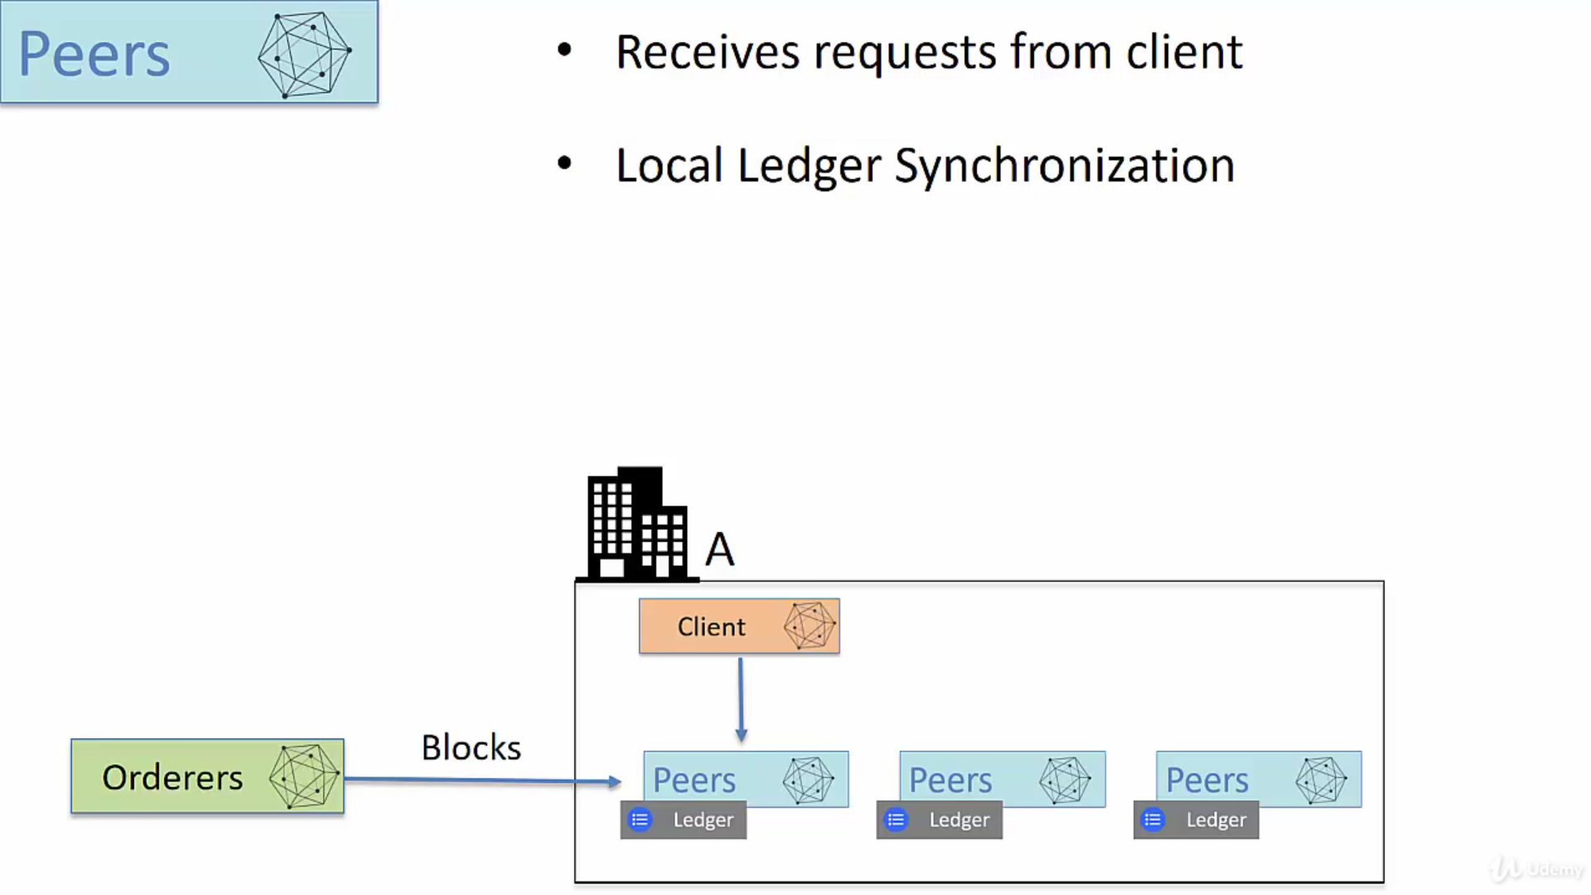
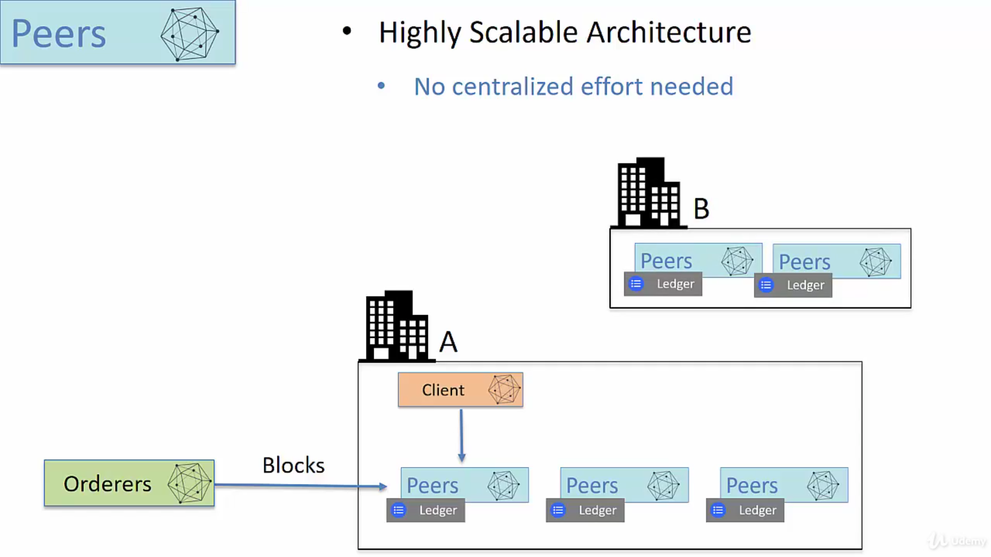

Slide 22
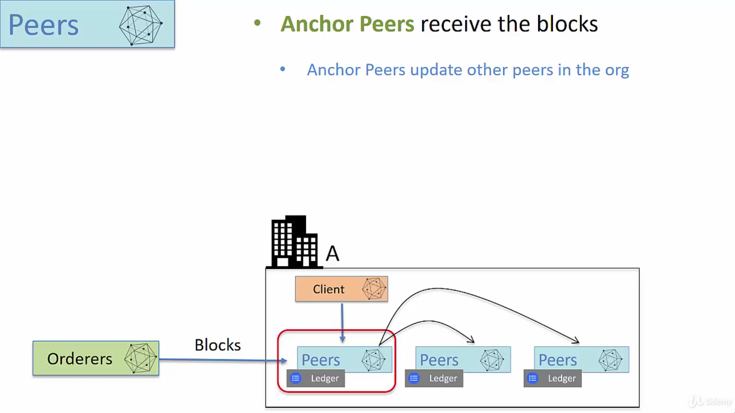

Slide 23
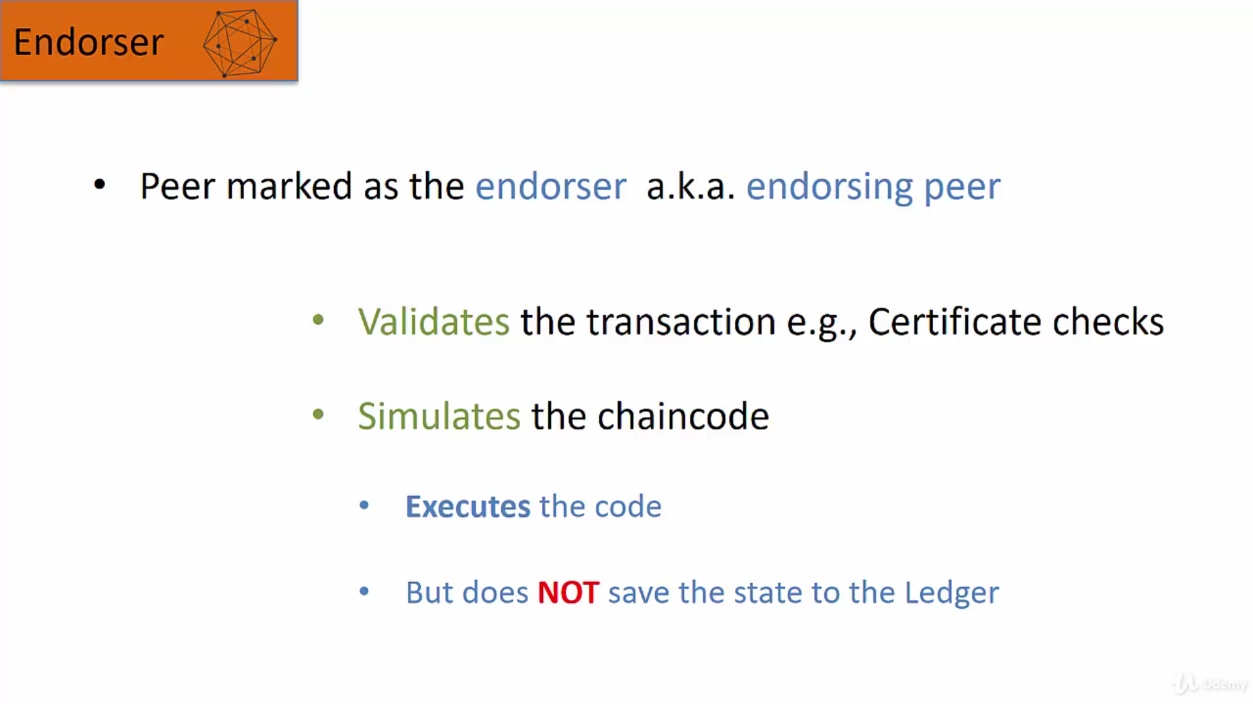
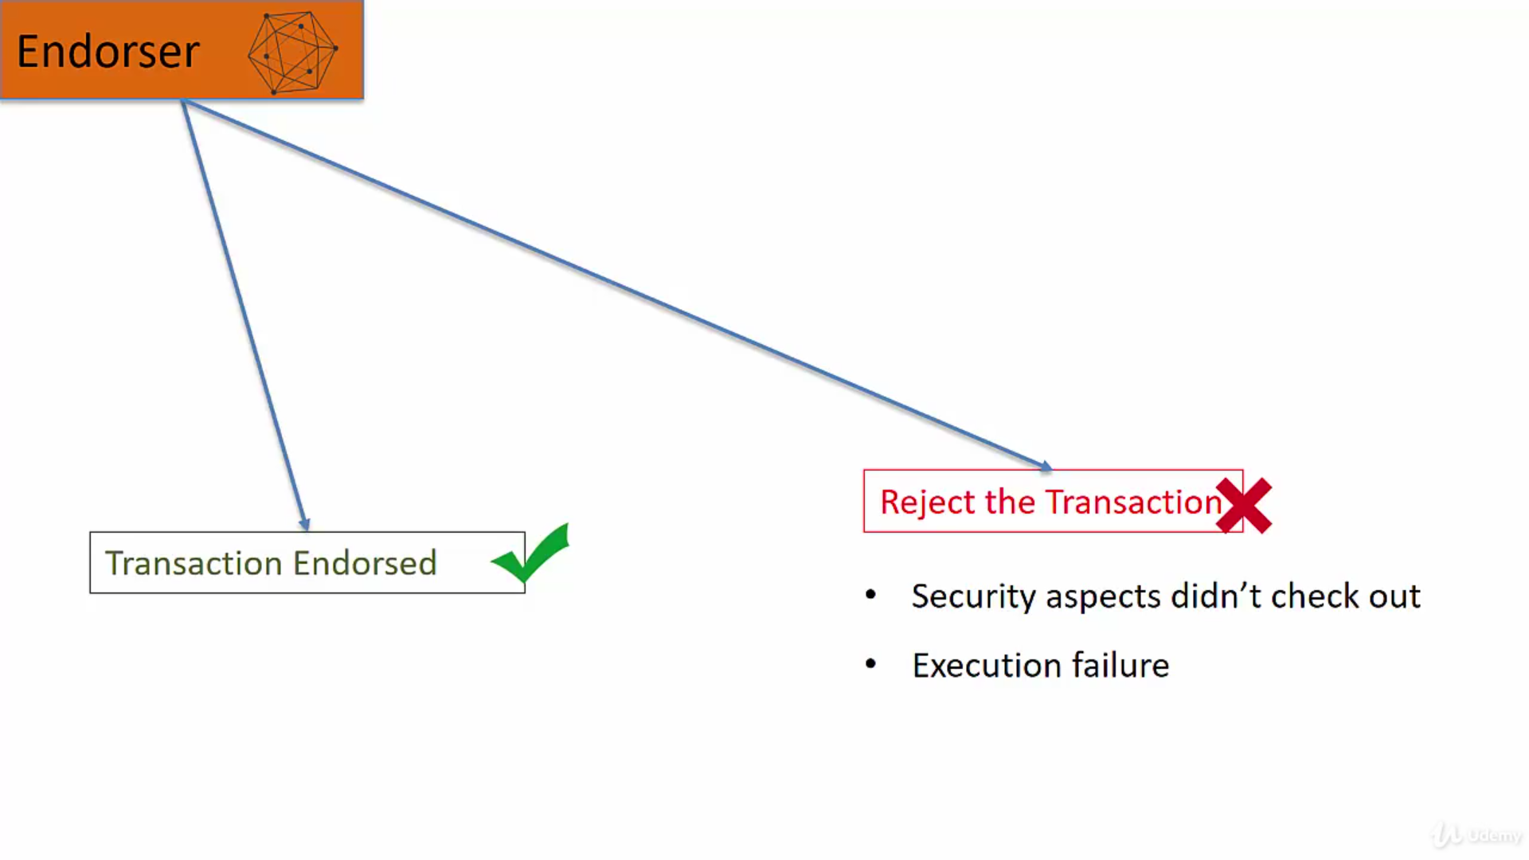

Slide 24
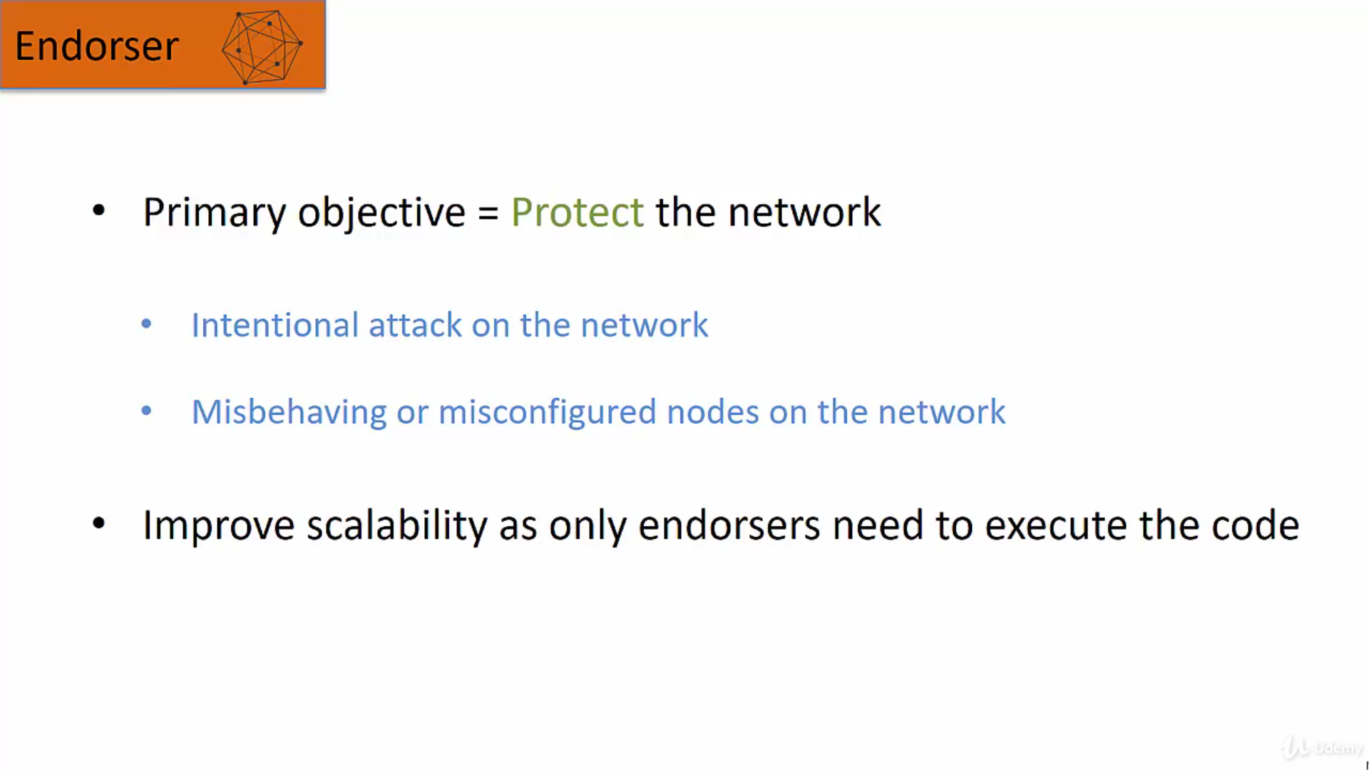
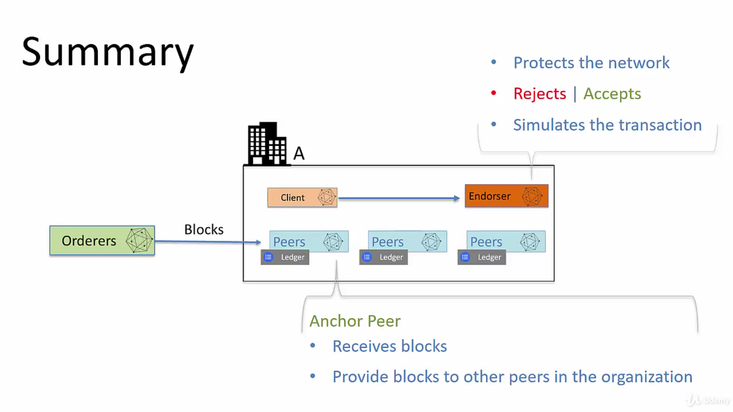

Slide 25
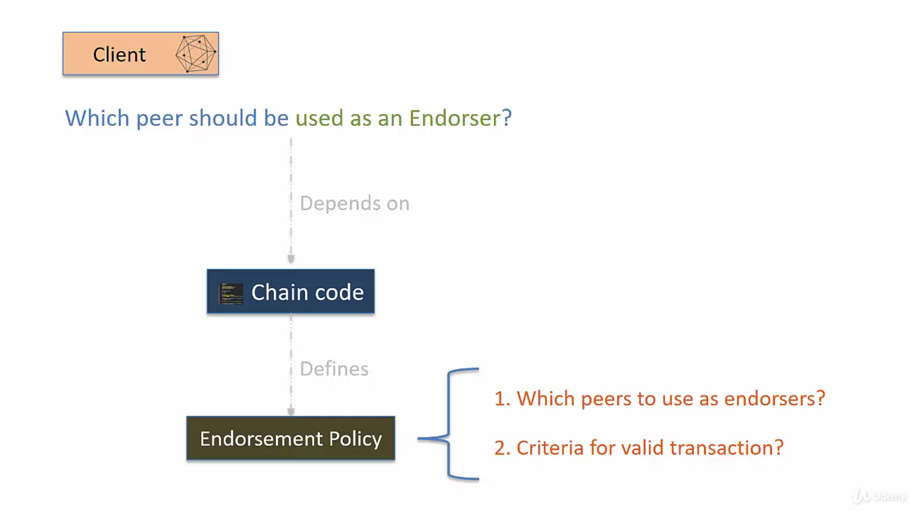
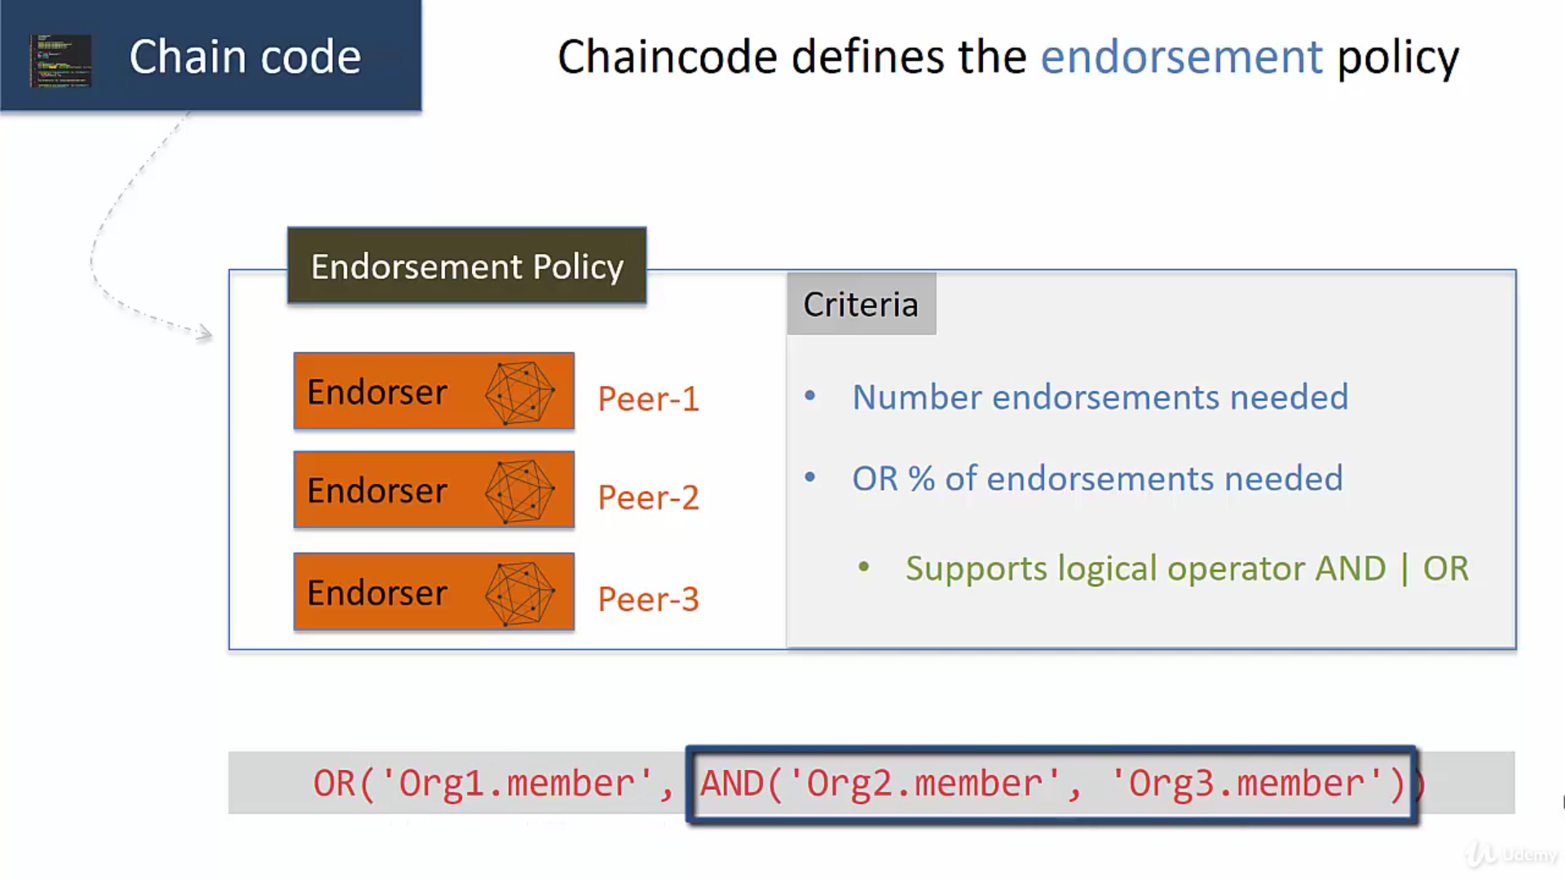

Slide 26
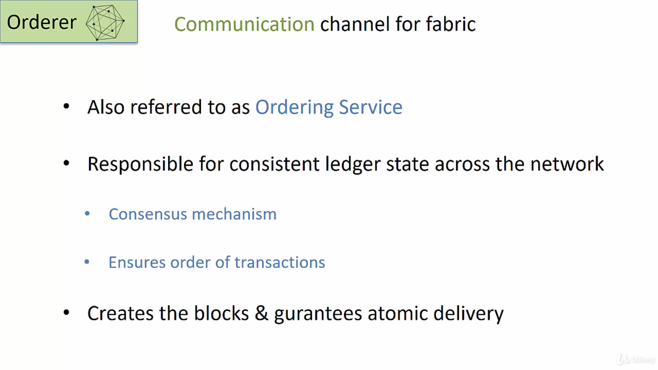
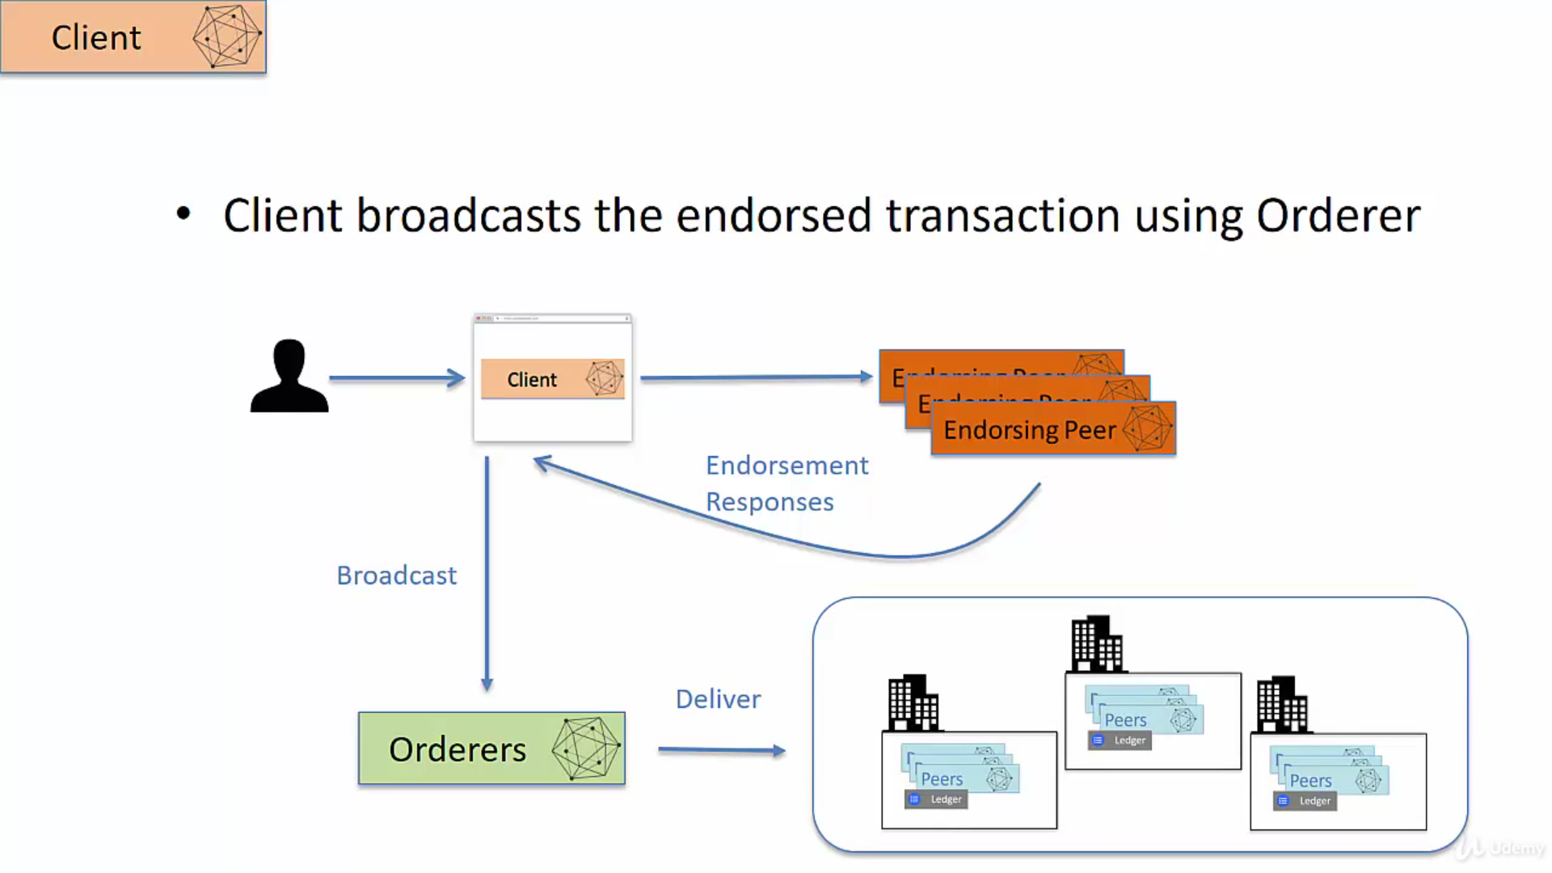

Slide 27
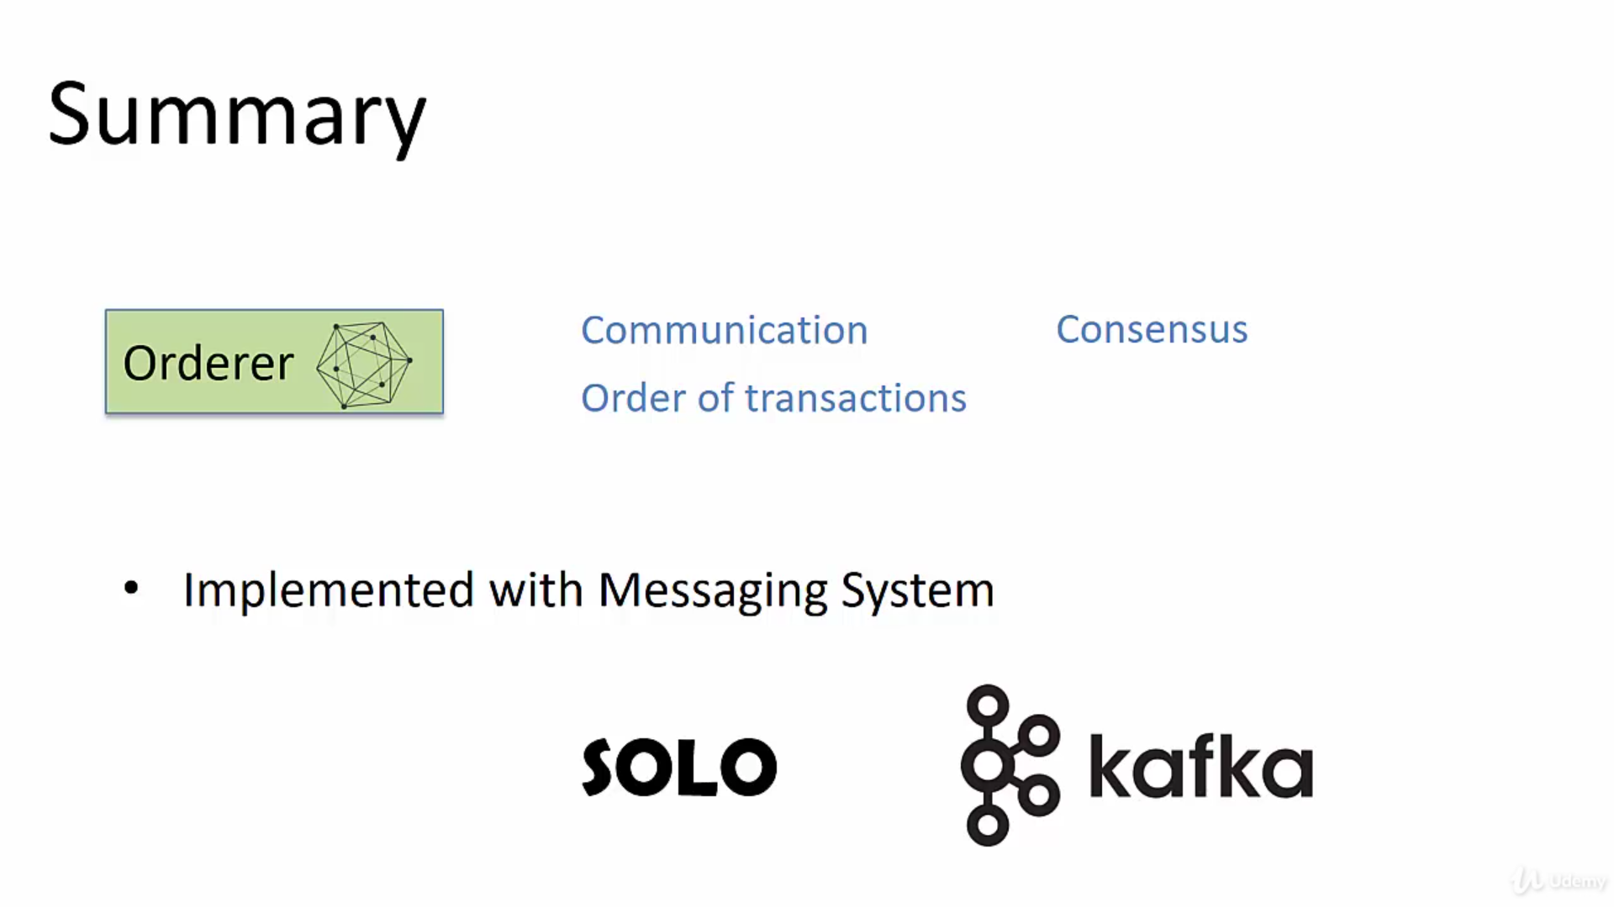

Slide 28
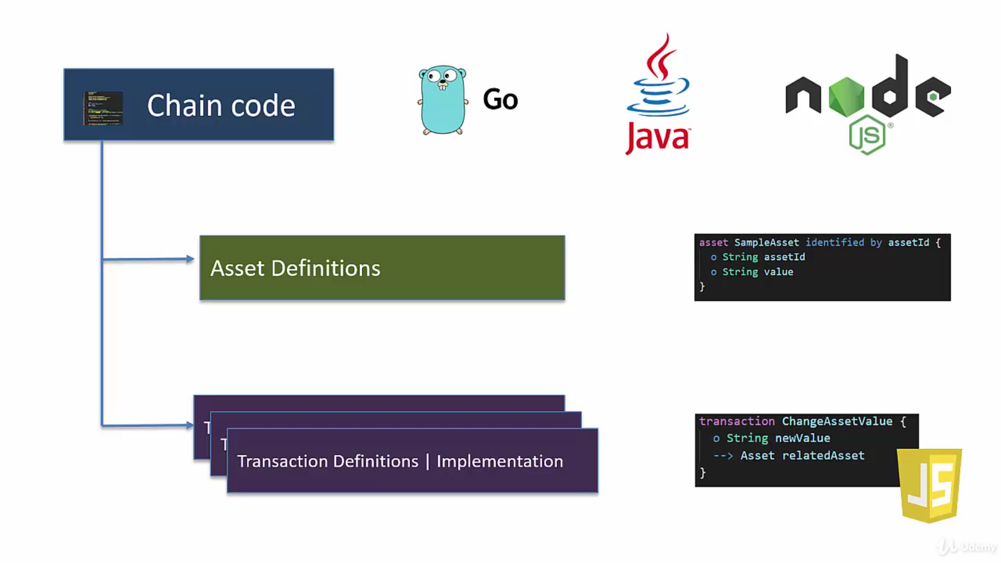
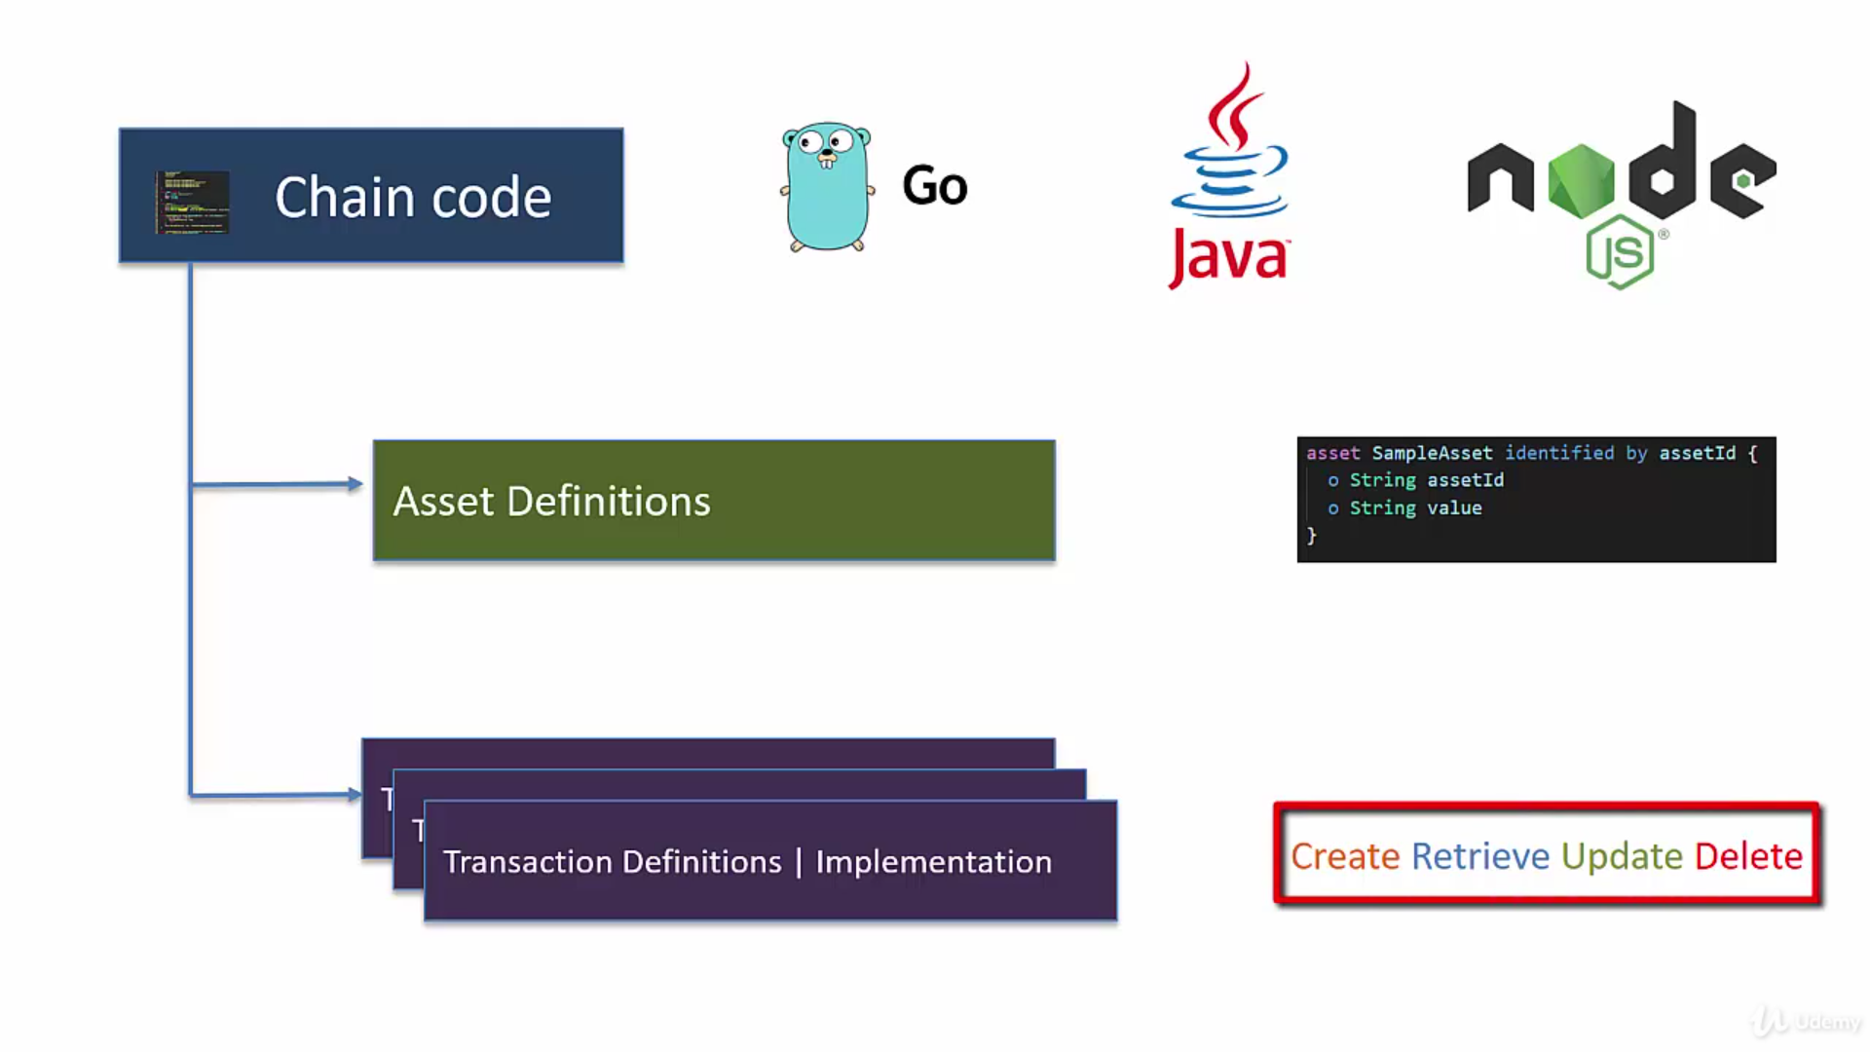

Slide 29
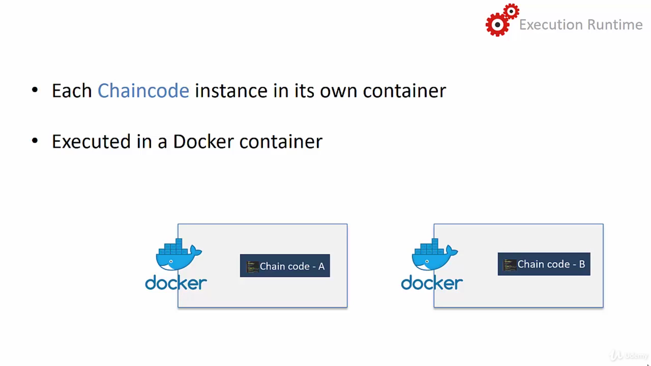
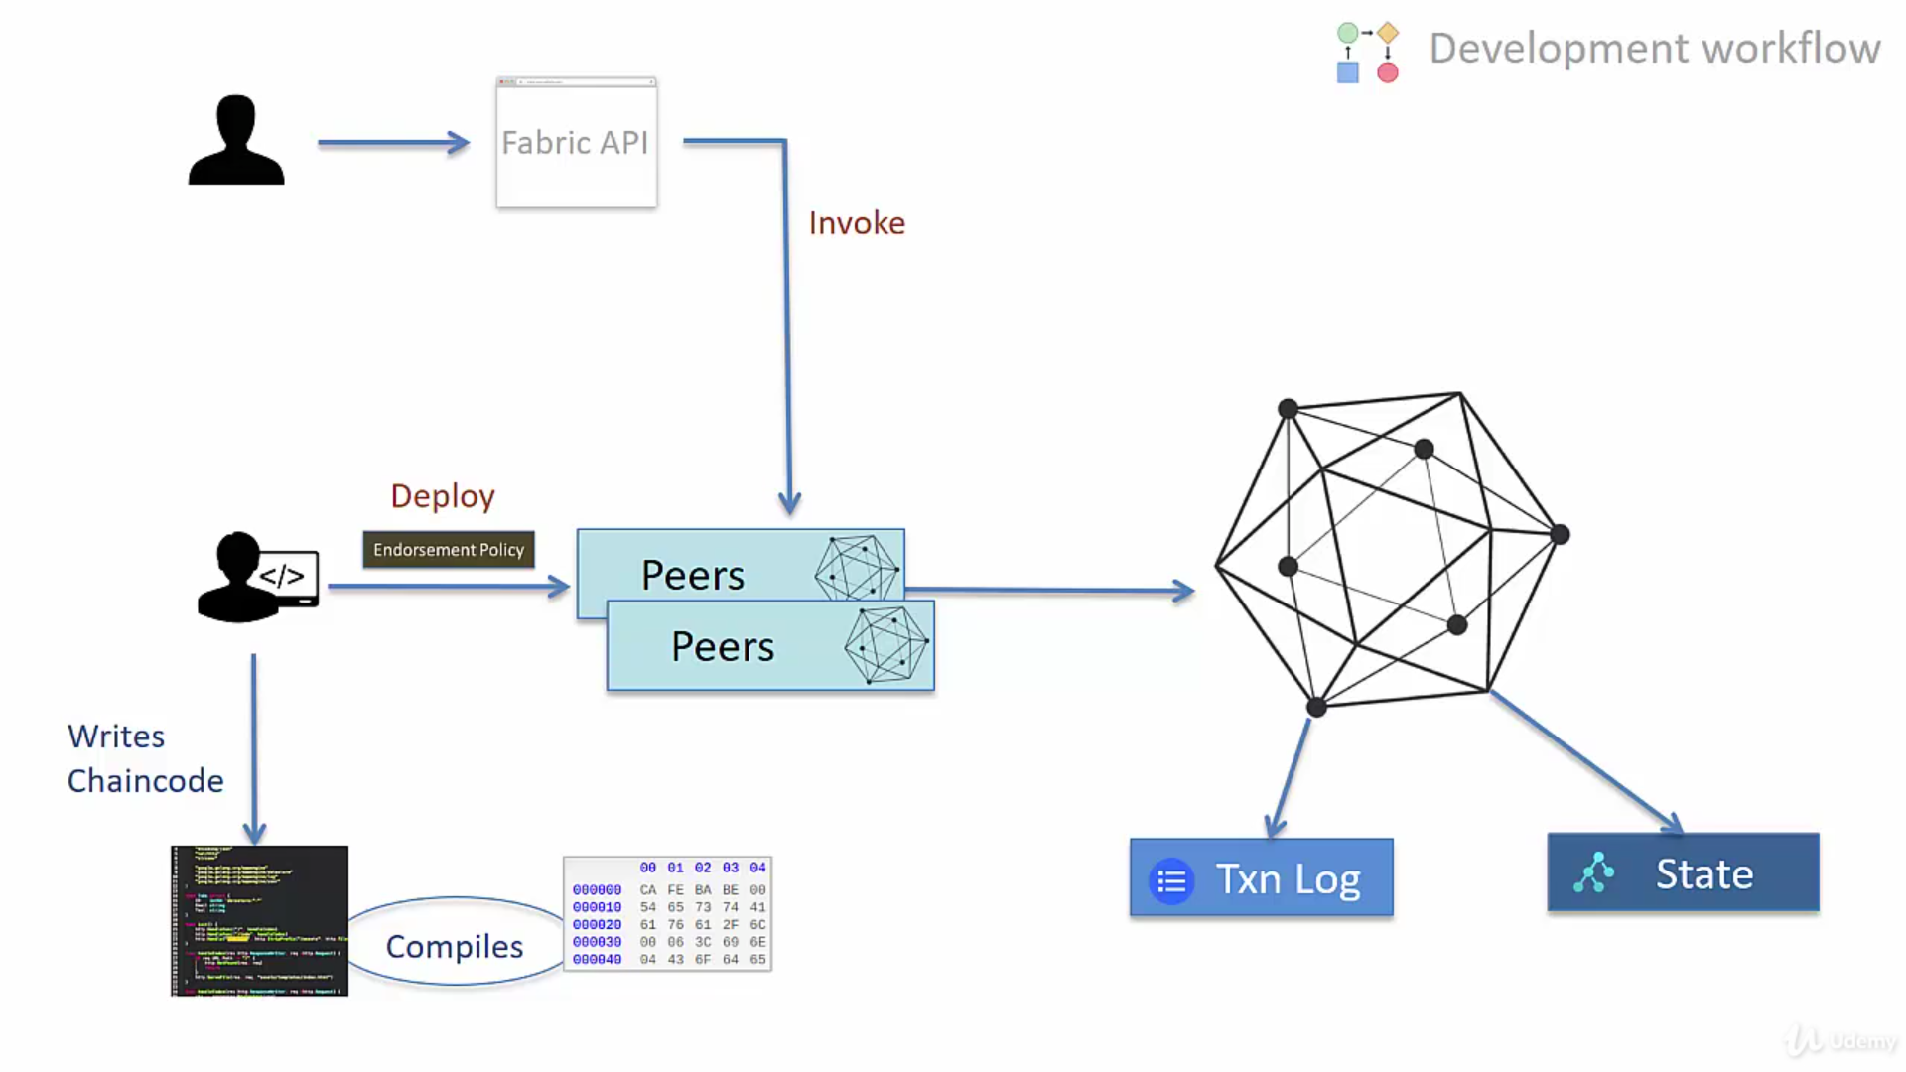

Slide 30
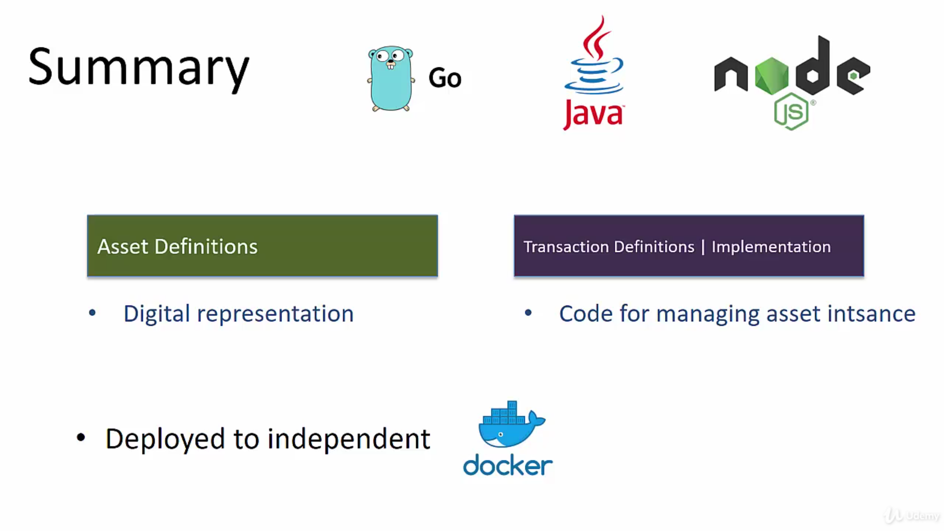

Slide 31
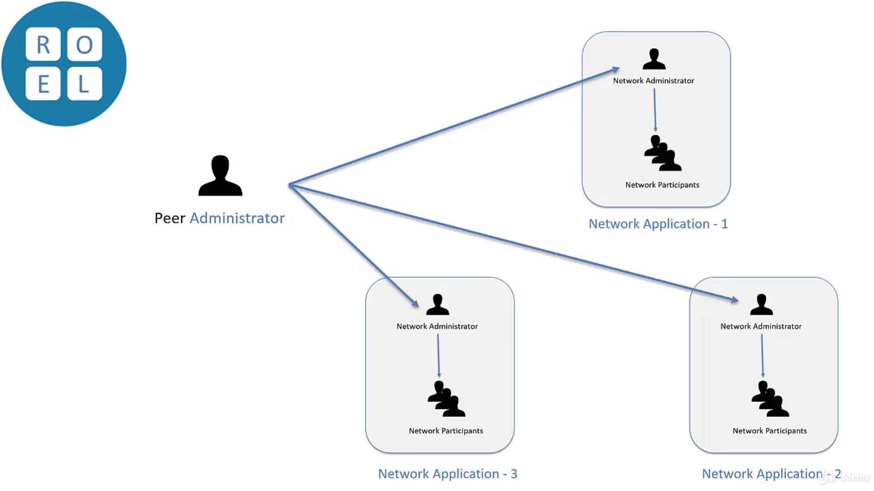

Slide 32
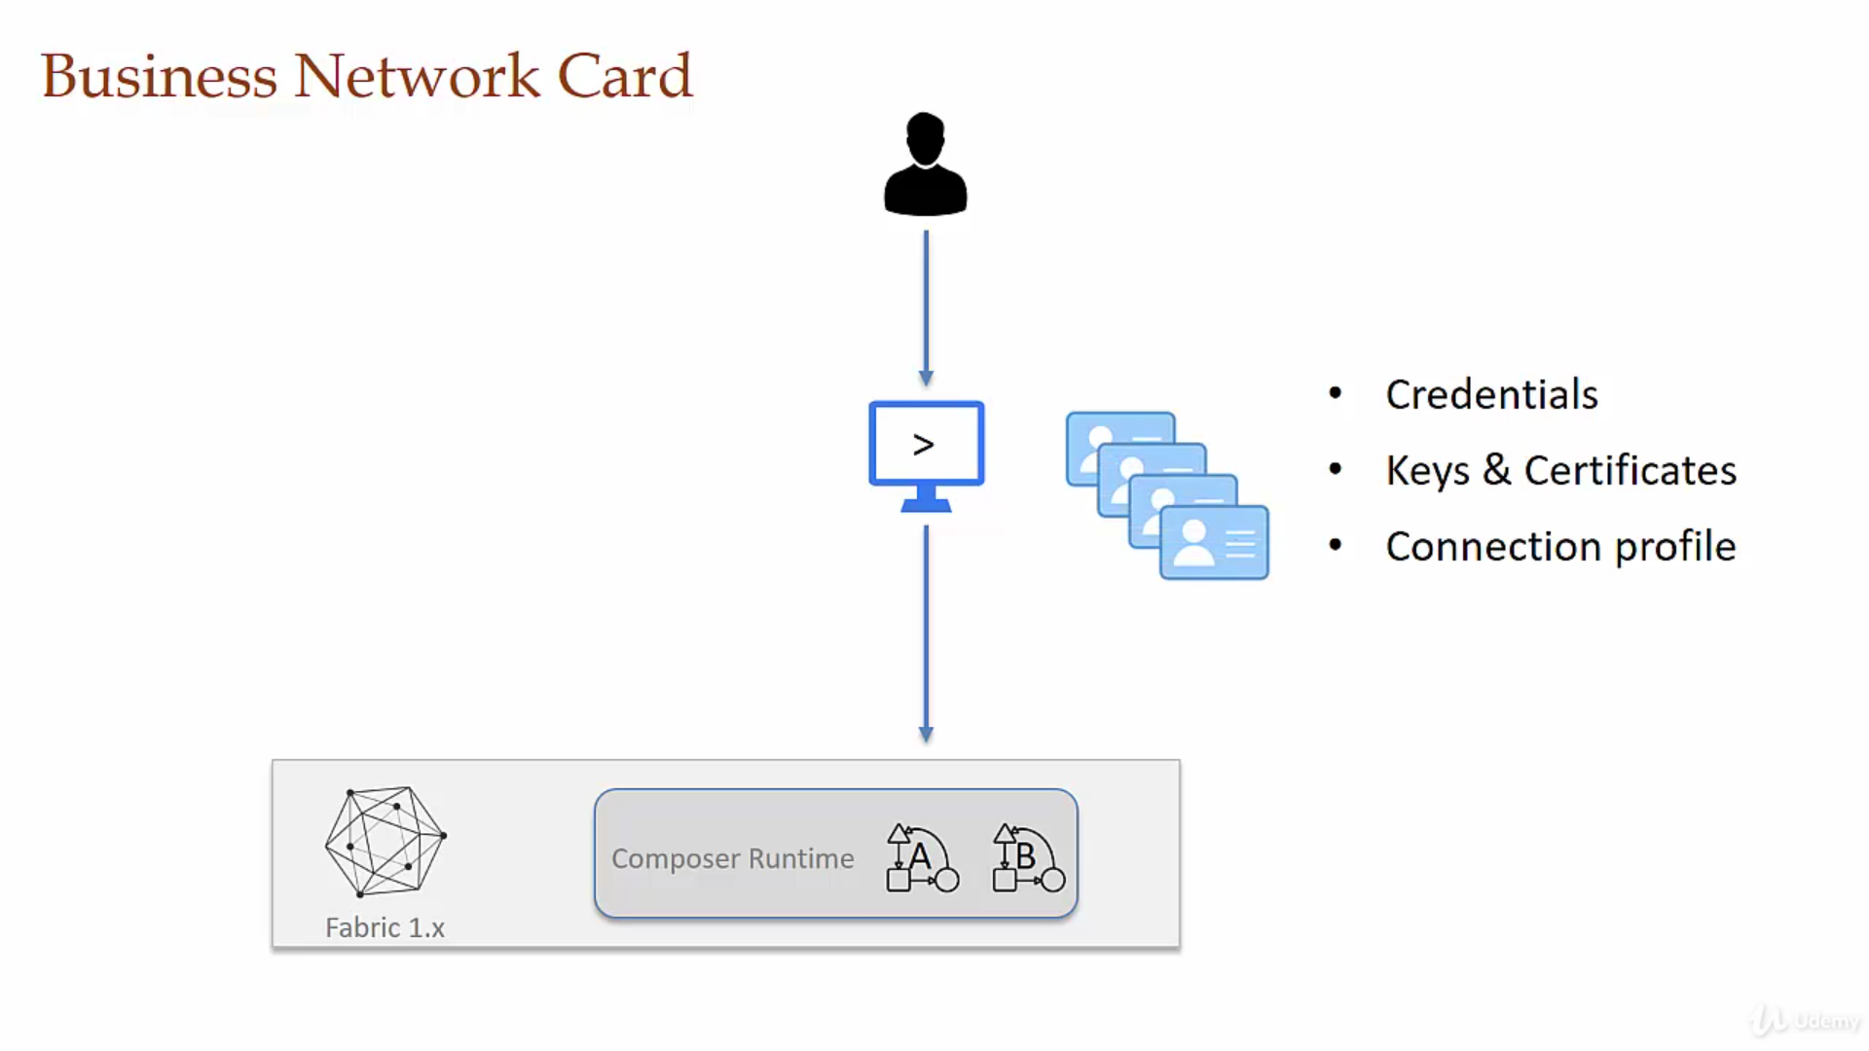
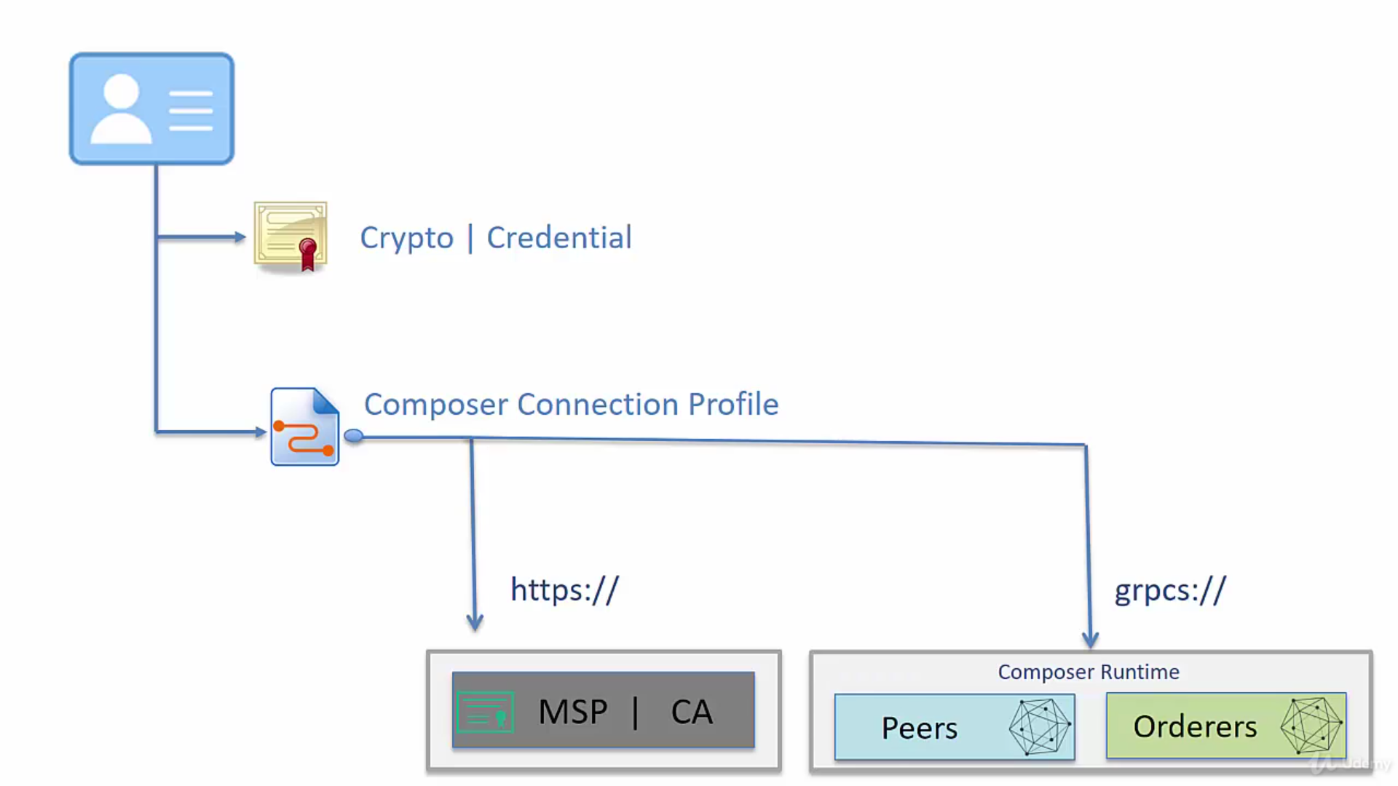

Slide 33
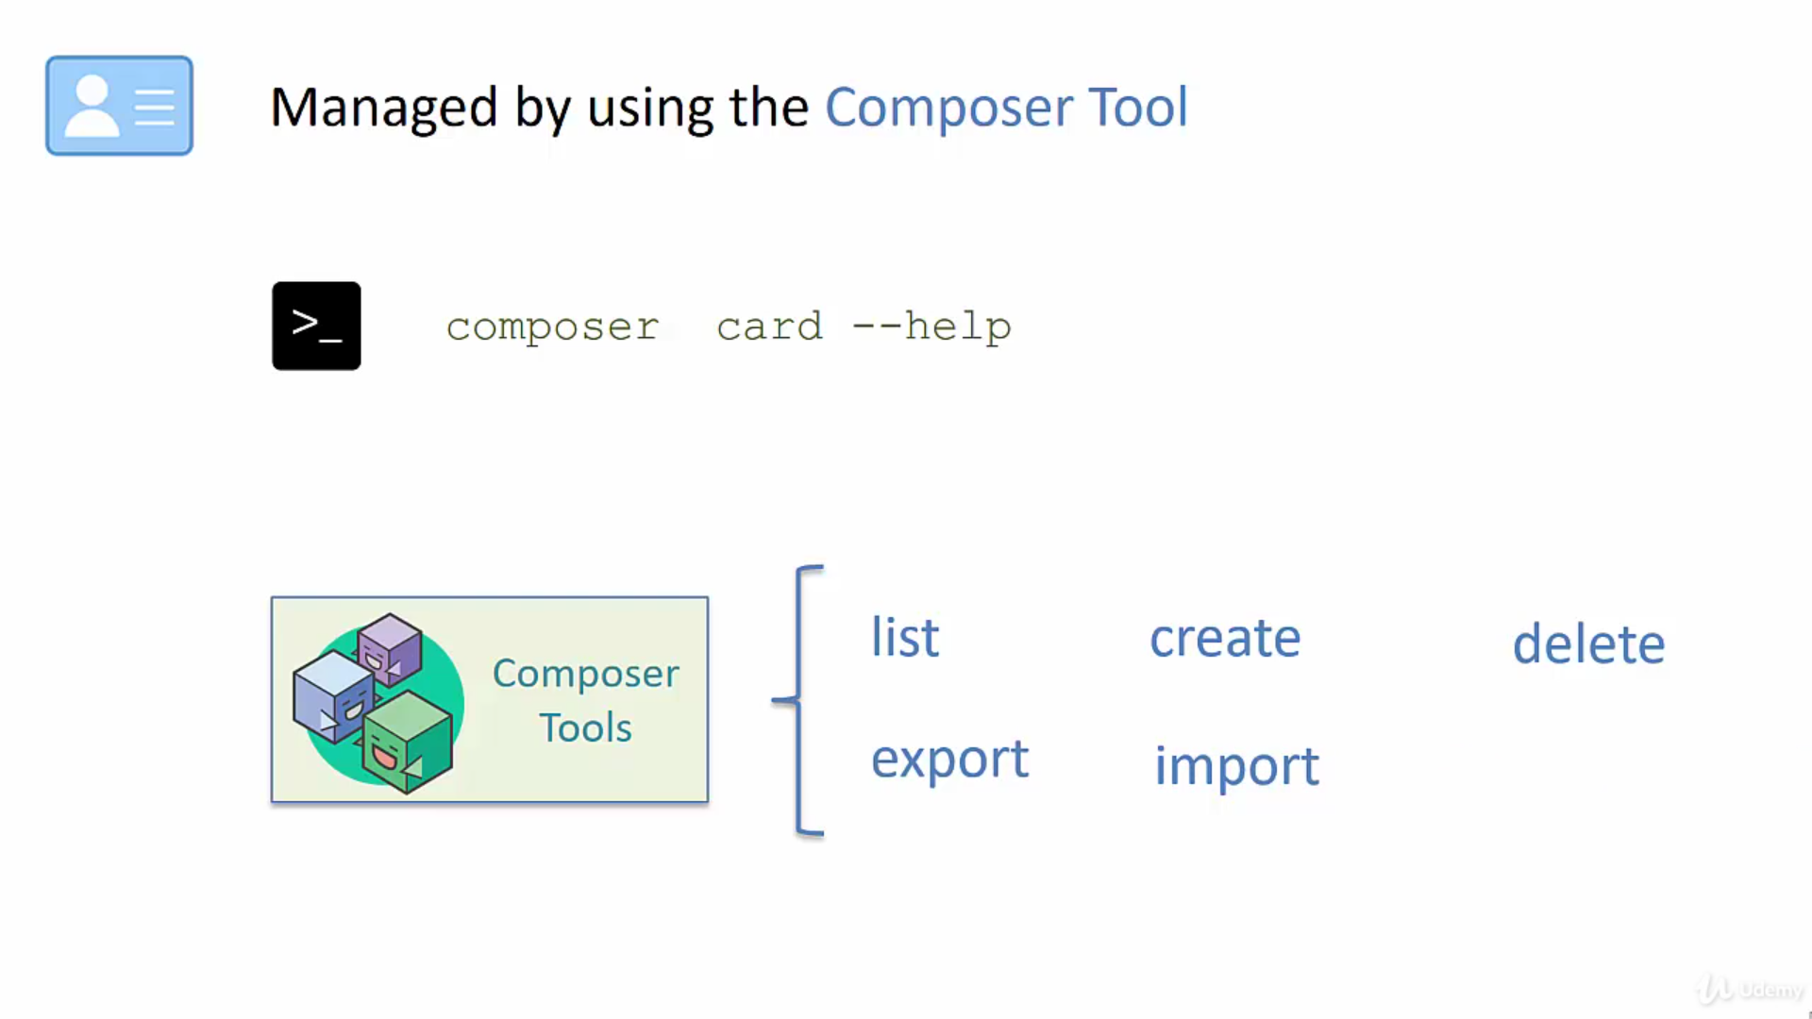
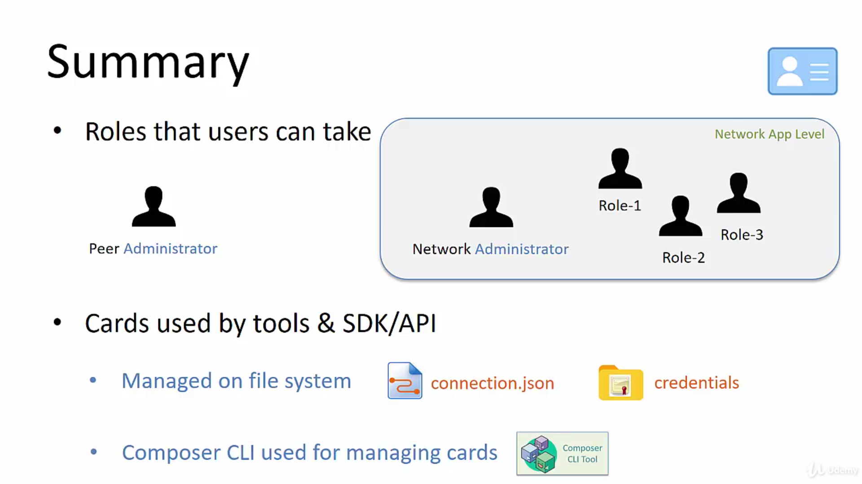

Slide 34
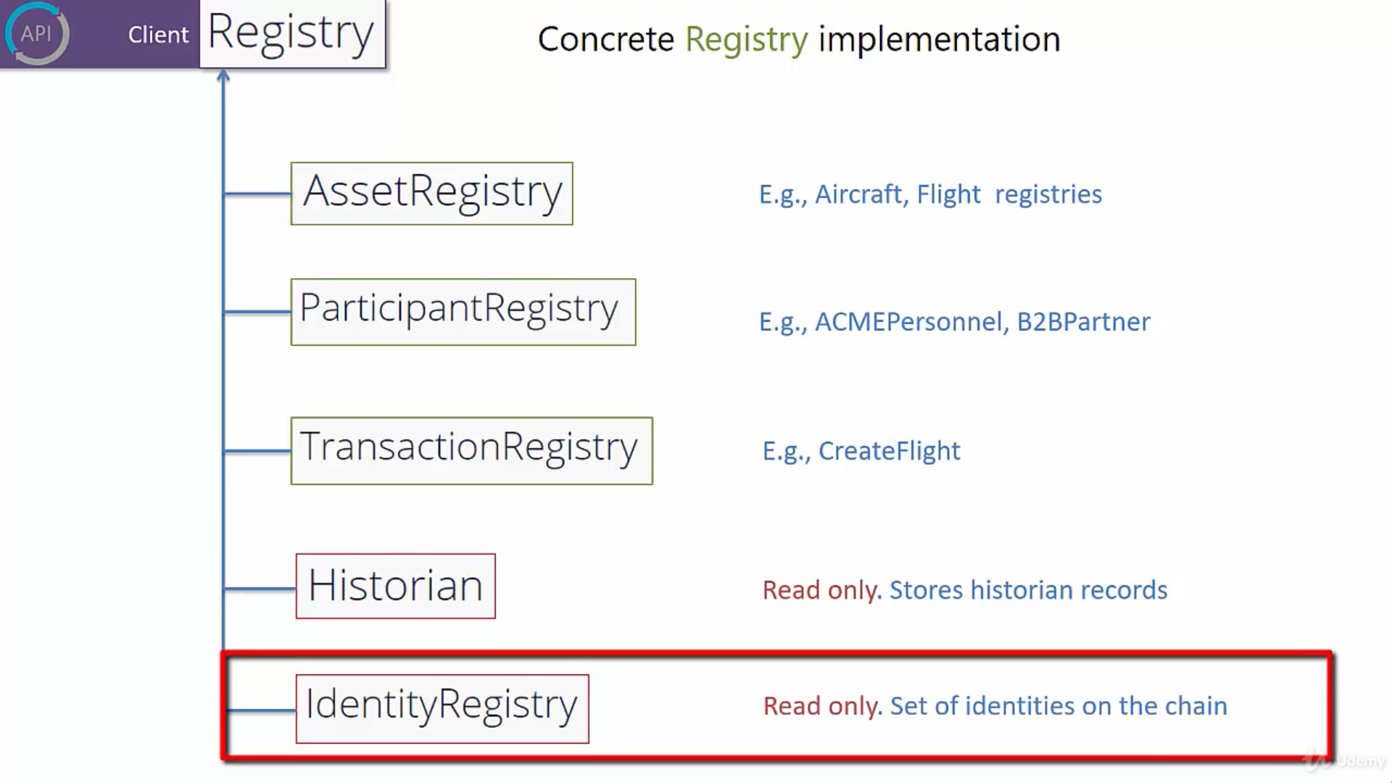
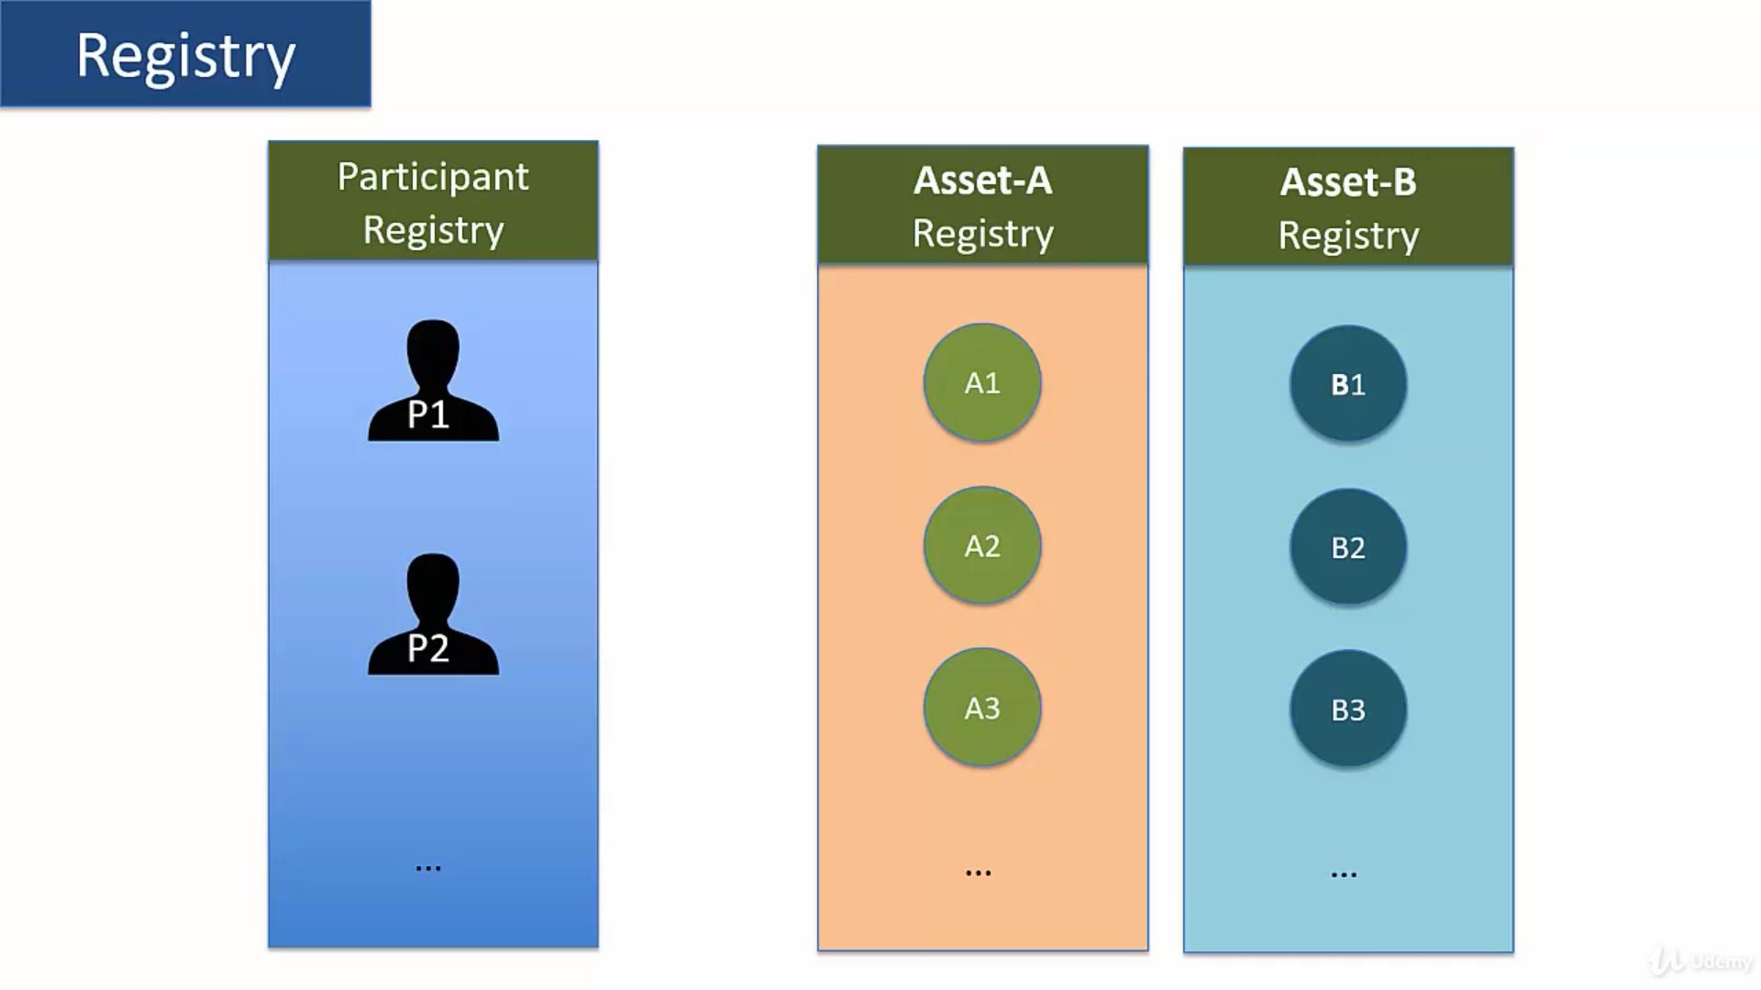

Slide 36
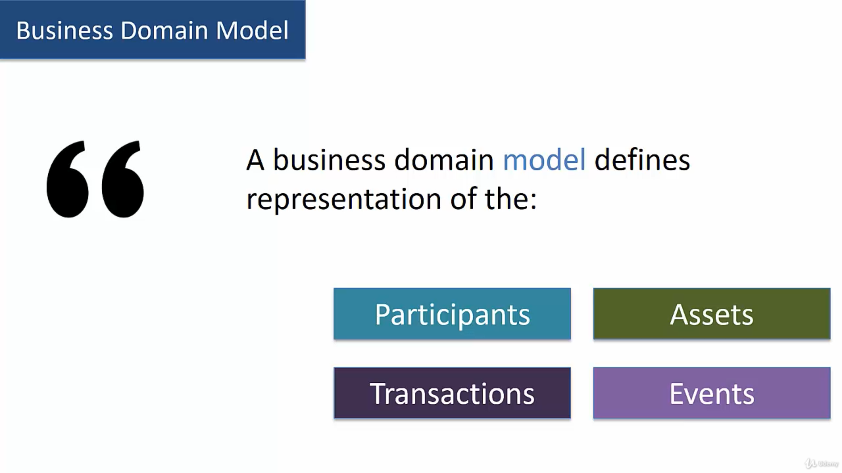

Slide 37
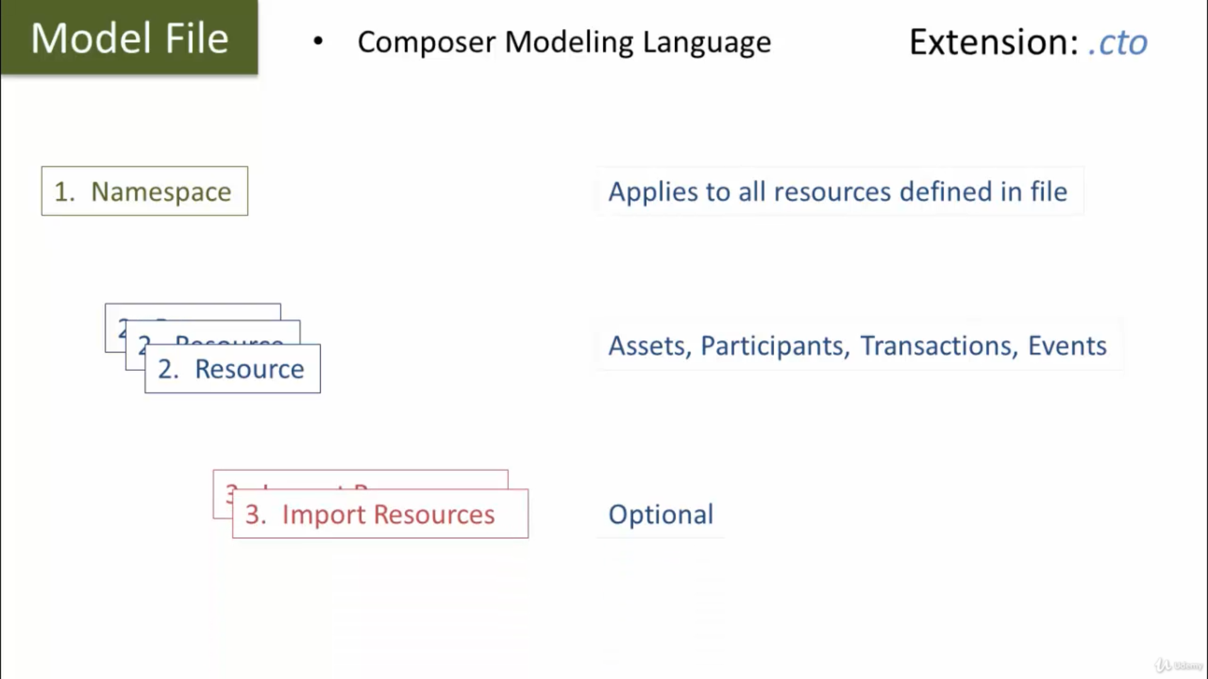

Slide 38
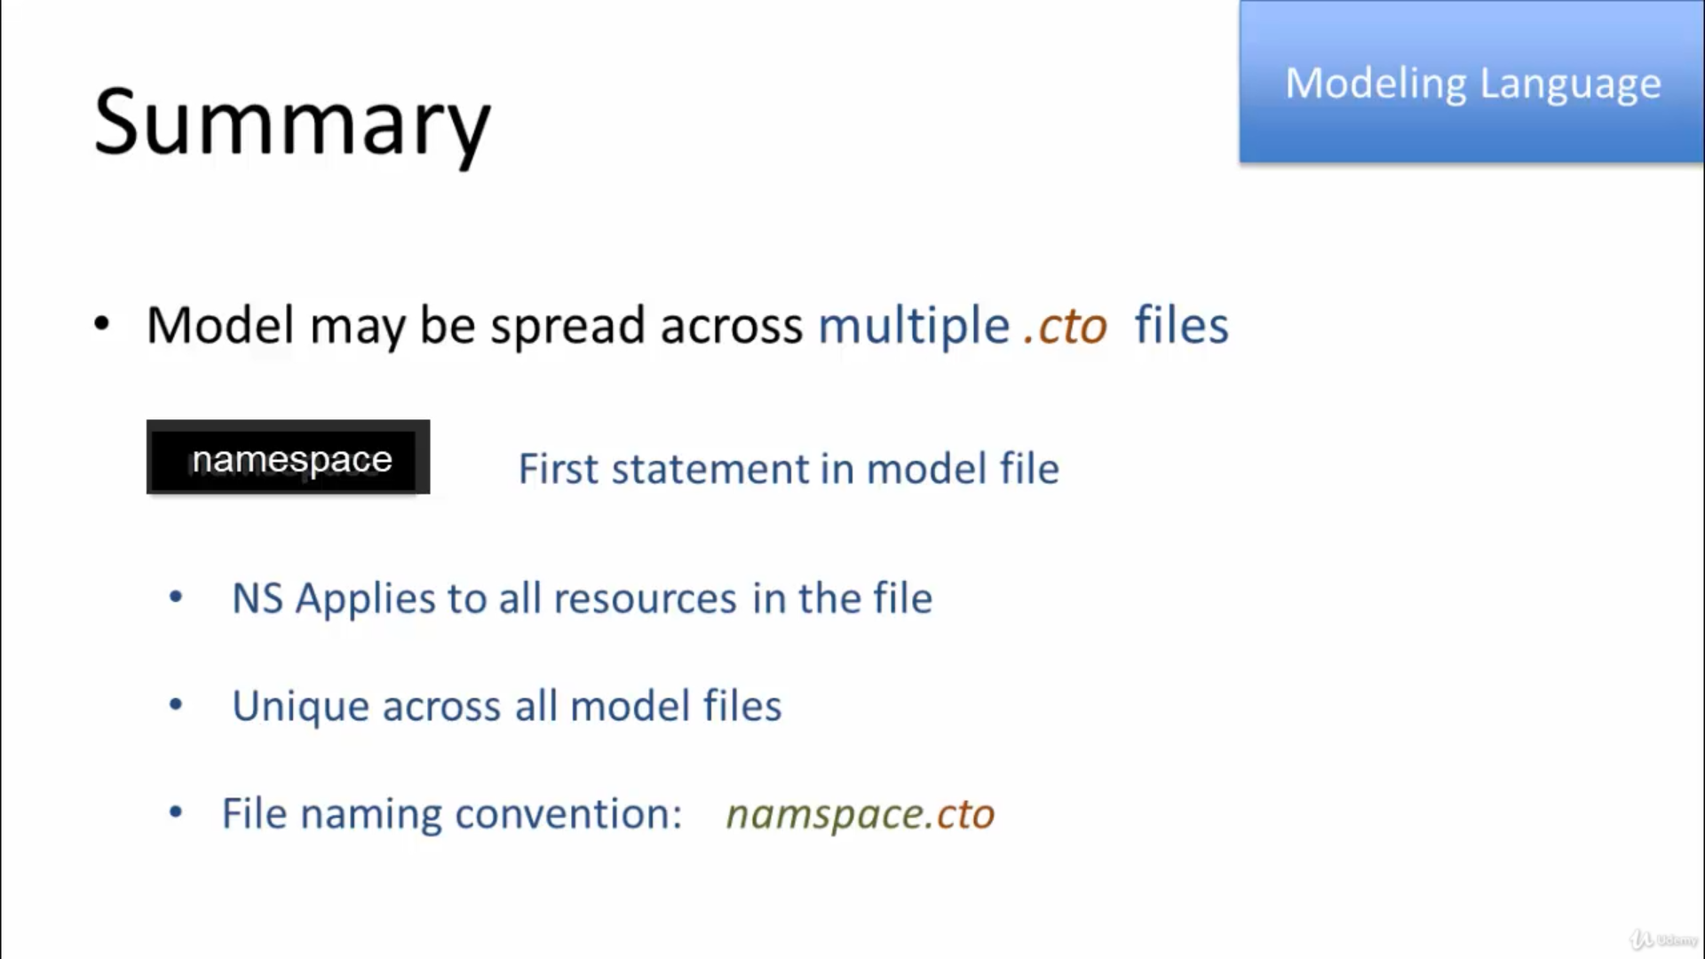

Slide 39
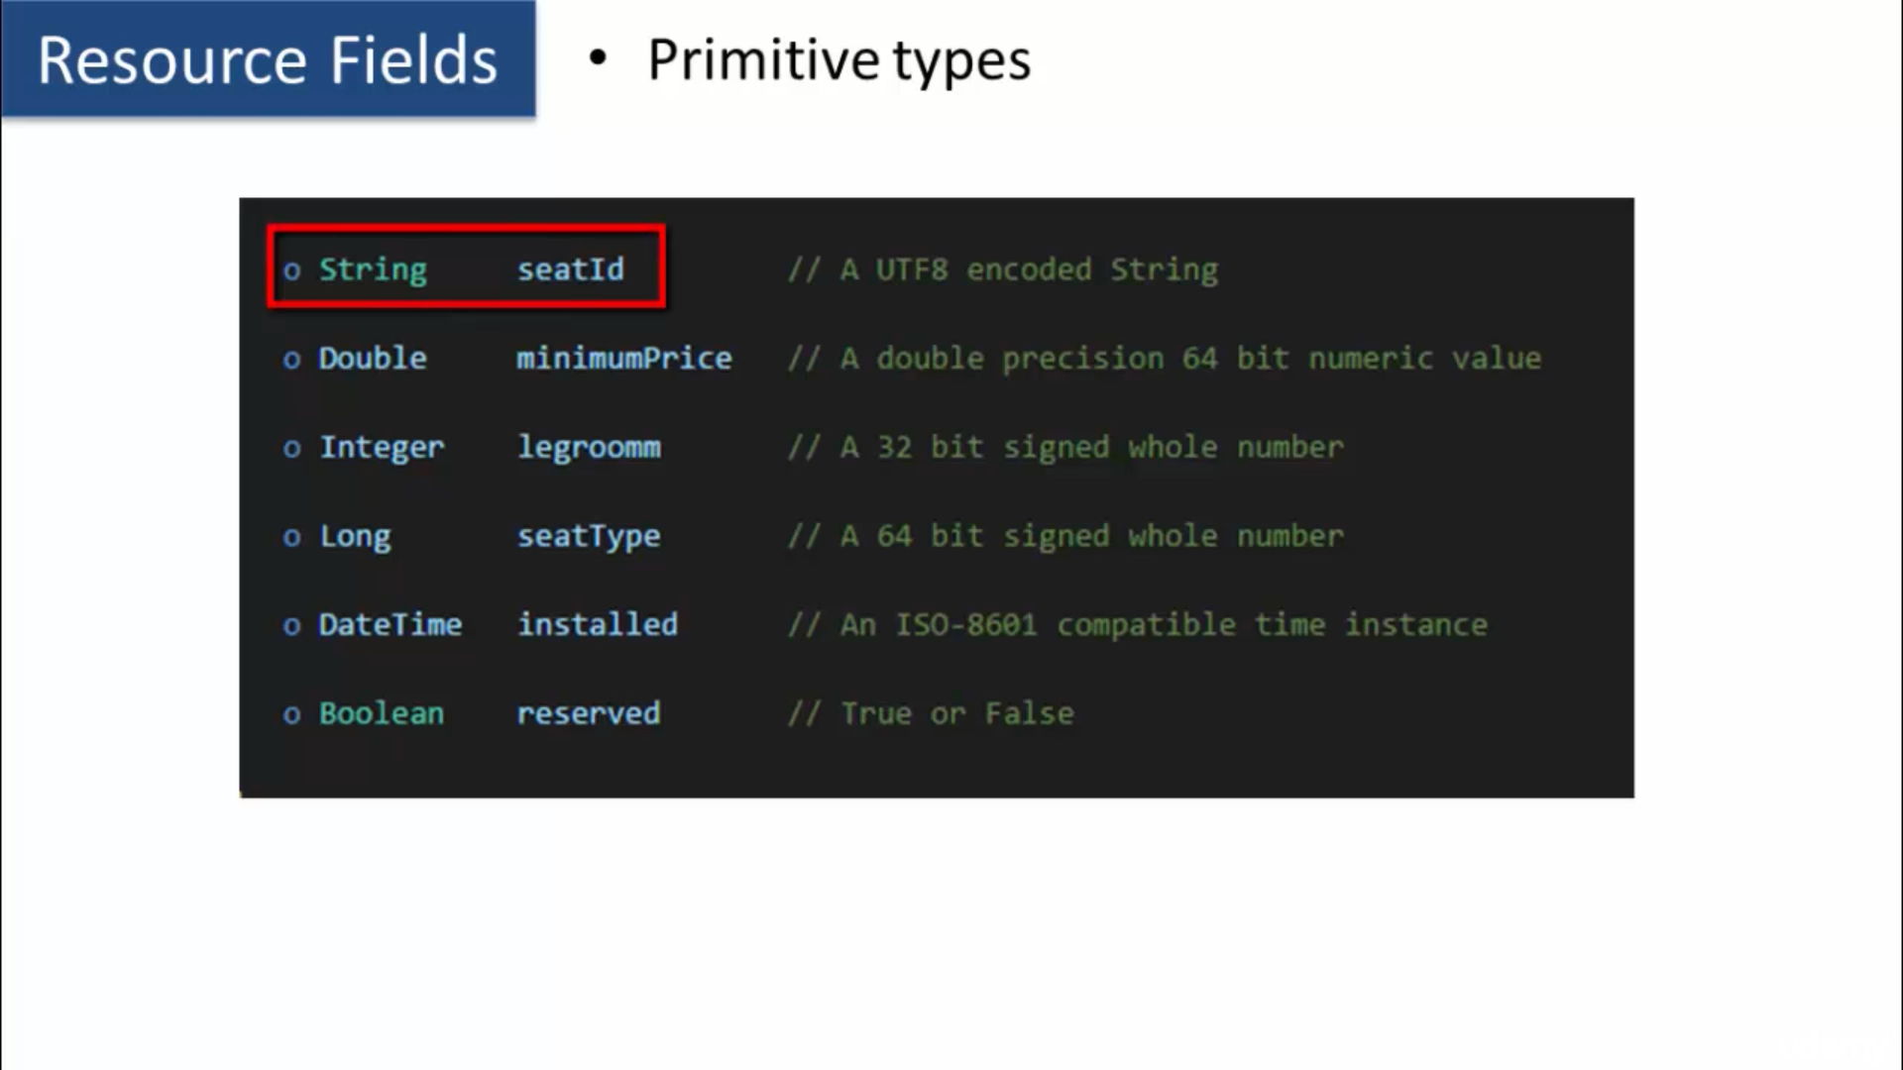

Slide 40
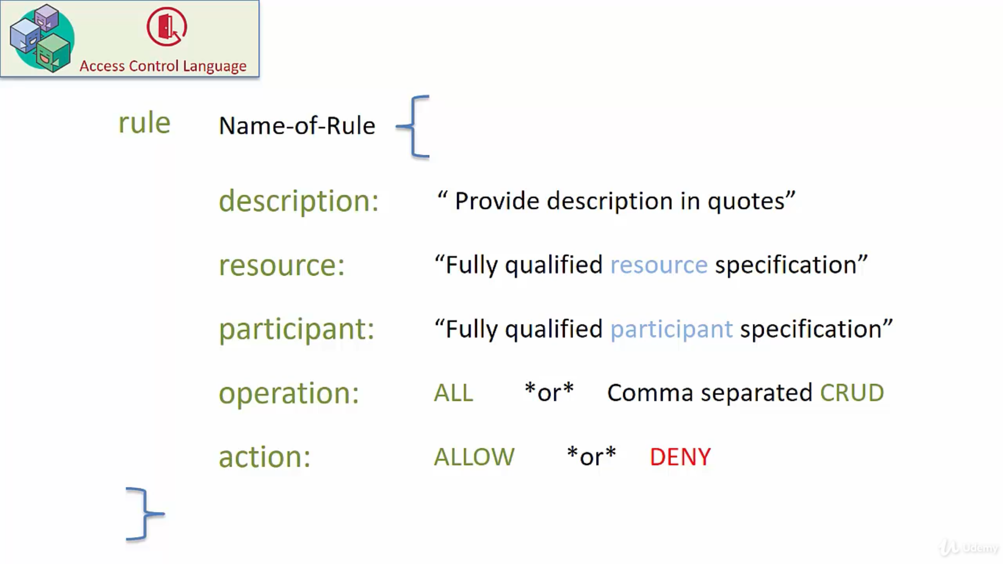

Slide 41
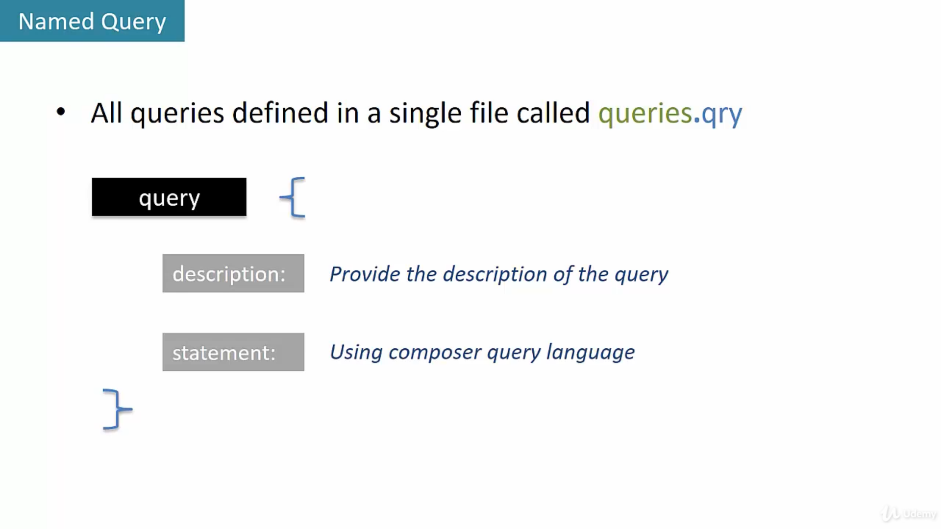

Slide 42
